Slide 1
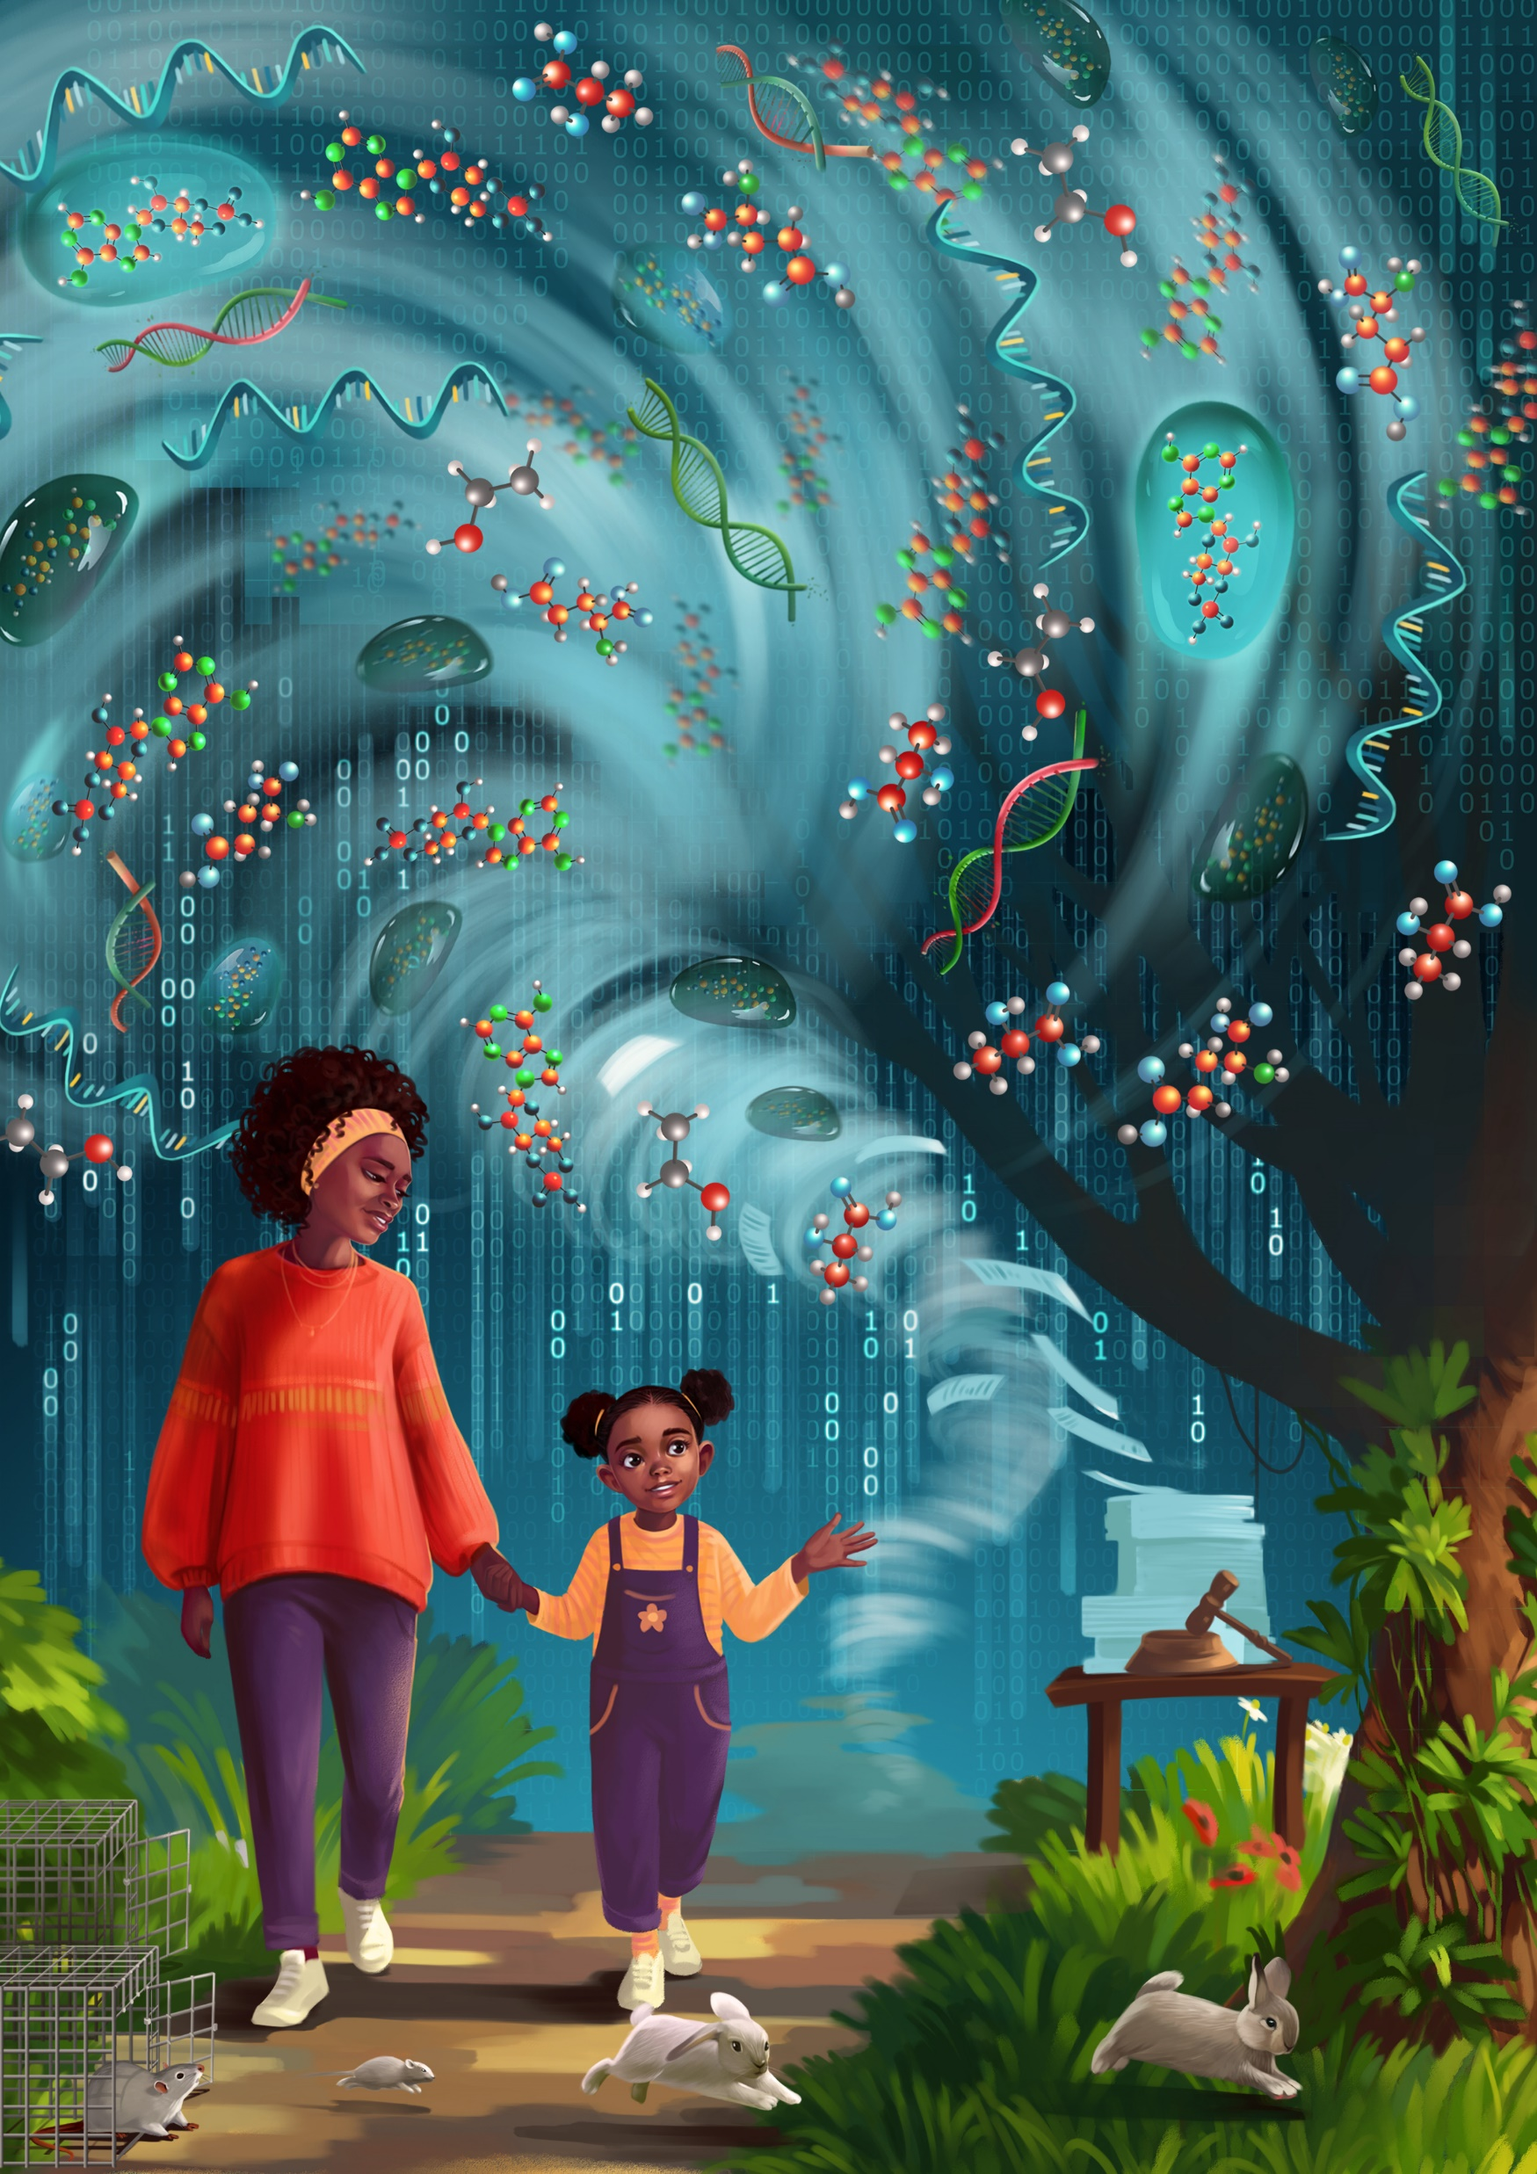


Marcin W. Wojewodzic,
Senior Researcher
Norwegian Institute of Public Health,
Cancer Registry of Norway
07.03.2025, OsloMet
Notes:
https://admin.sli.do/event/xmo5FMebonkczKkBNccvWt/polls
https://admin.sli.do/event/xmo5FMebonkczKkBNccvWt/polls
https://app.sli.do/event/xmo5FMebonkczKkBNccvWt

Slide 2
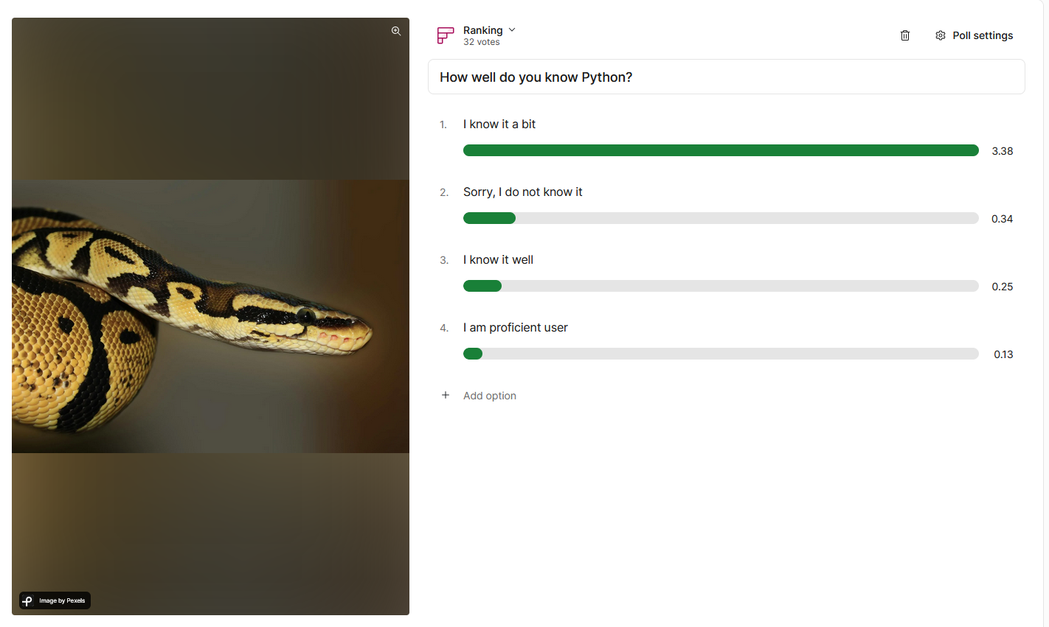

Slide 3
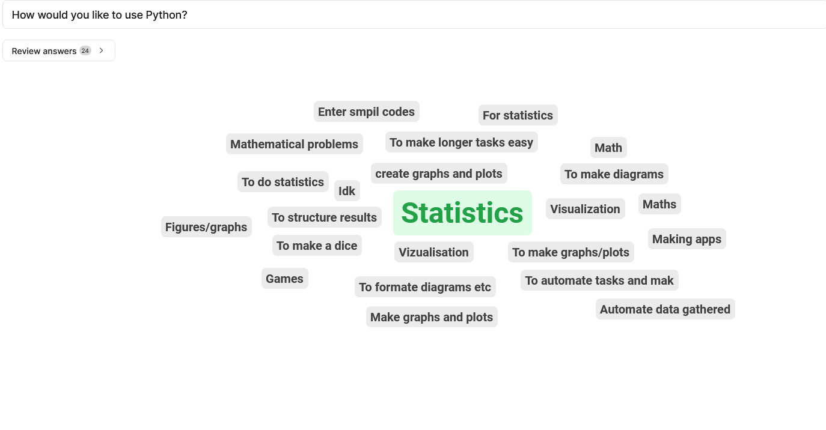

Slide 4
Today tasks
Toolbox for bioinformatics
Slido

Slide 5
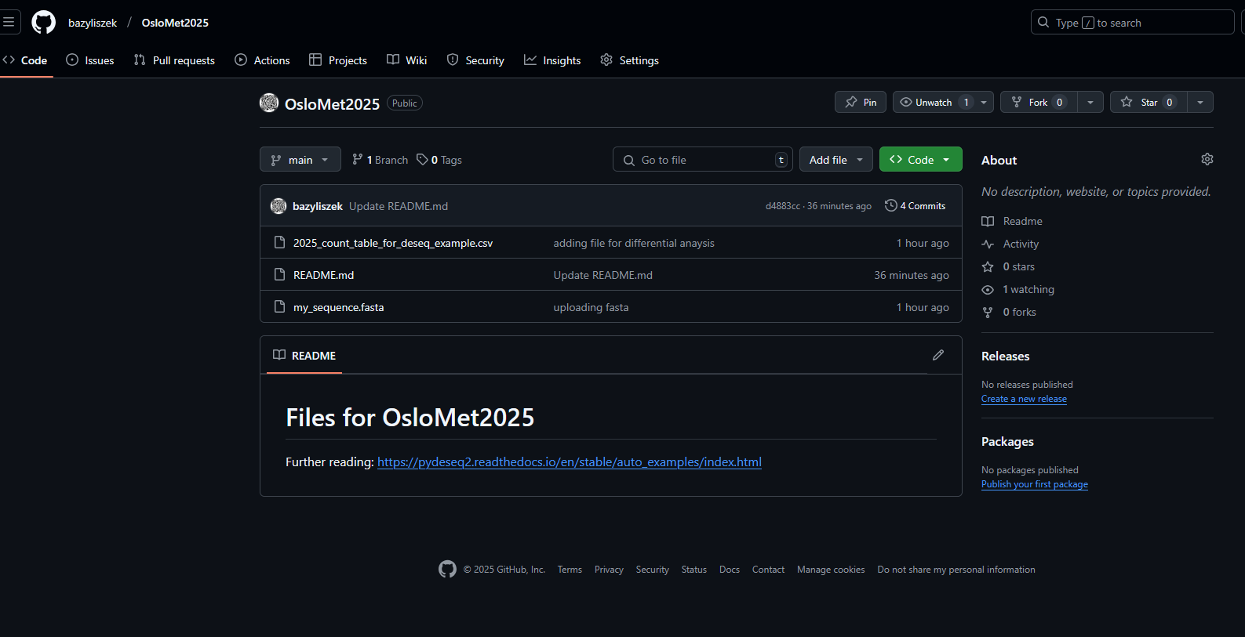
Check your email for links:
https://github.com/bazyliszek/OsloMet2025

Slide 6
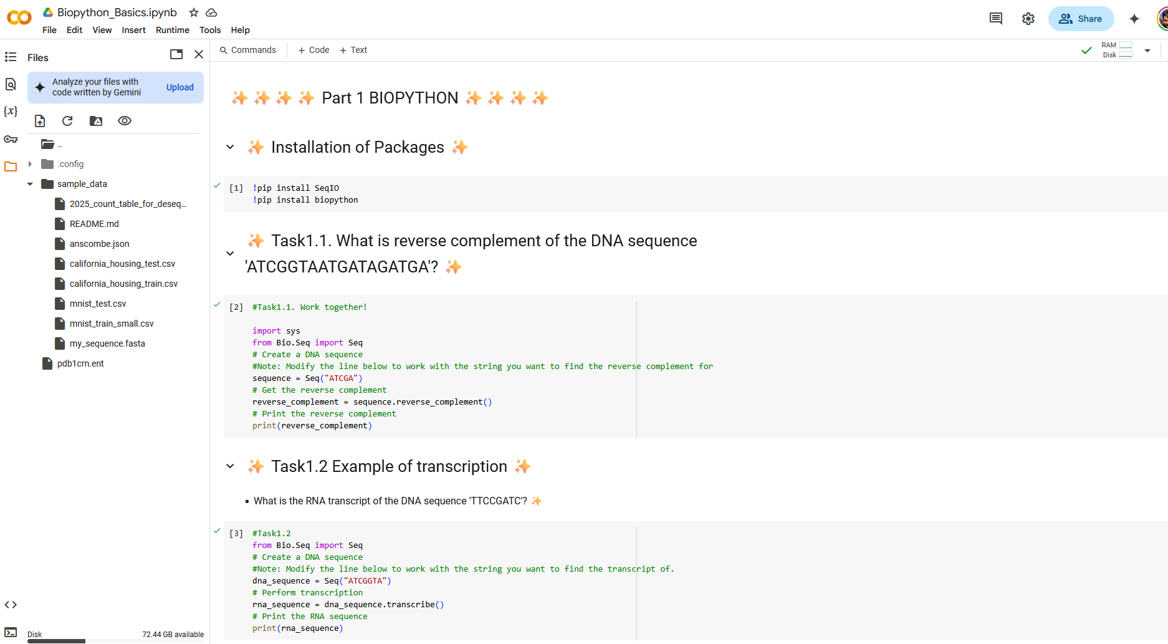
https://colab.research.google.com/drive/1Mpyixpcu75rwM17OolBFIogP9kBqpw-T?usp=sharing
Make a copy

Slide 7
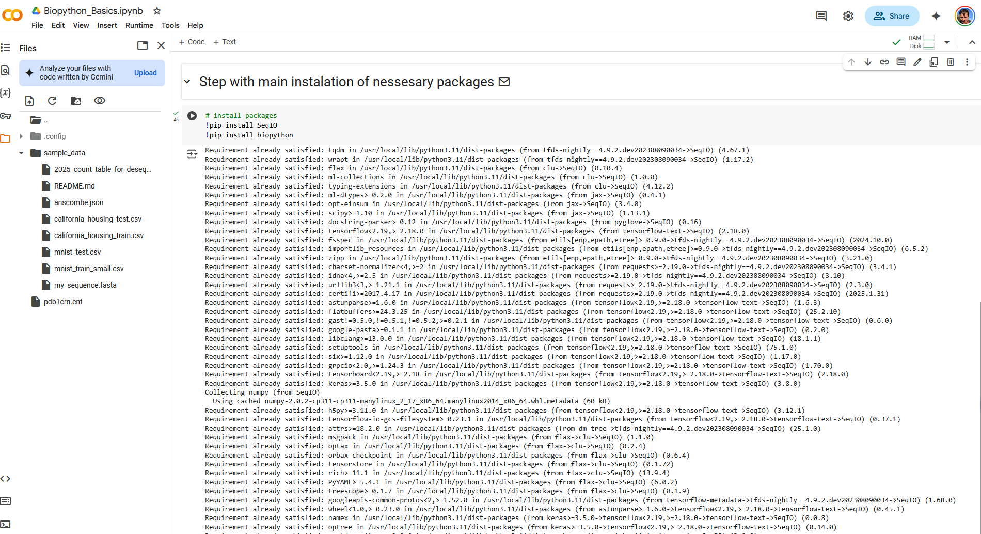

Slide 8
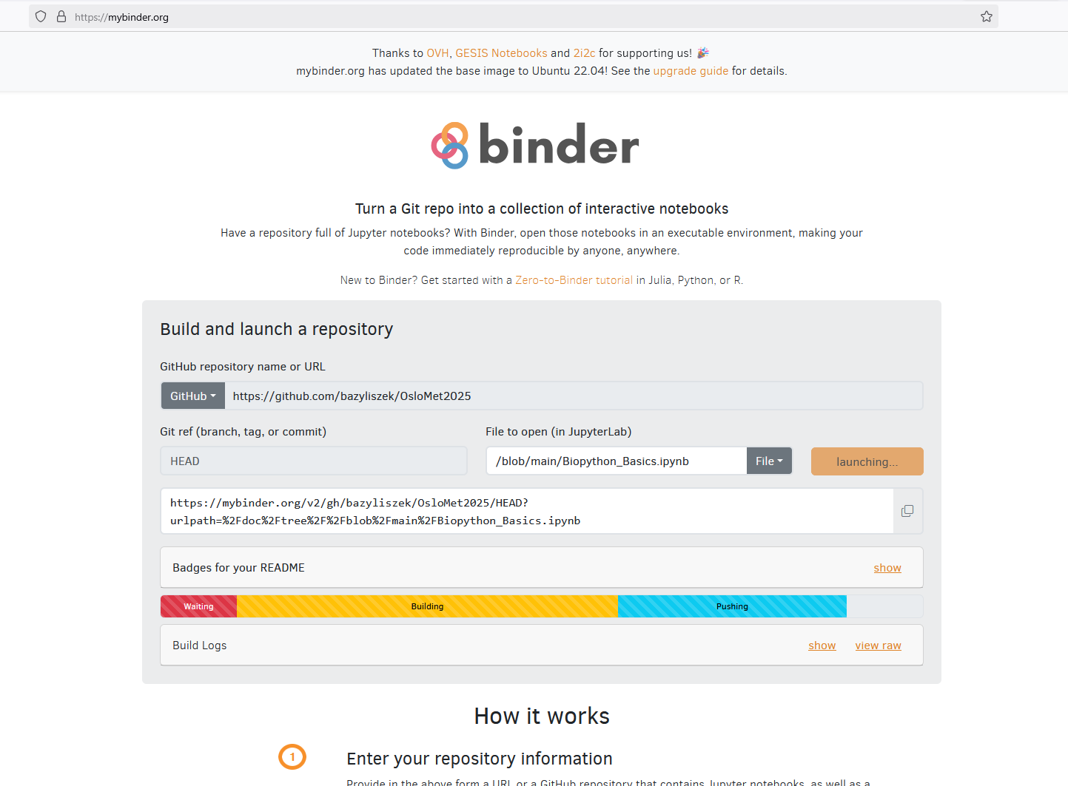
2. Generate a Binder Link
Once your repository is ready:
Go to Binder:
Visit https://mybinder.org/
Enter Your GitHub Repository URL:

Slide 9
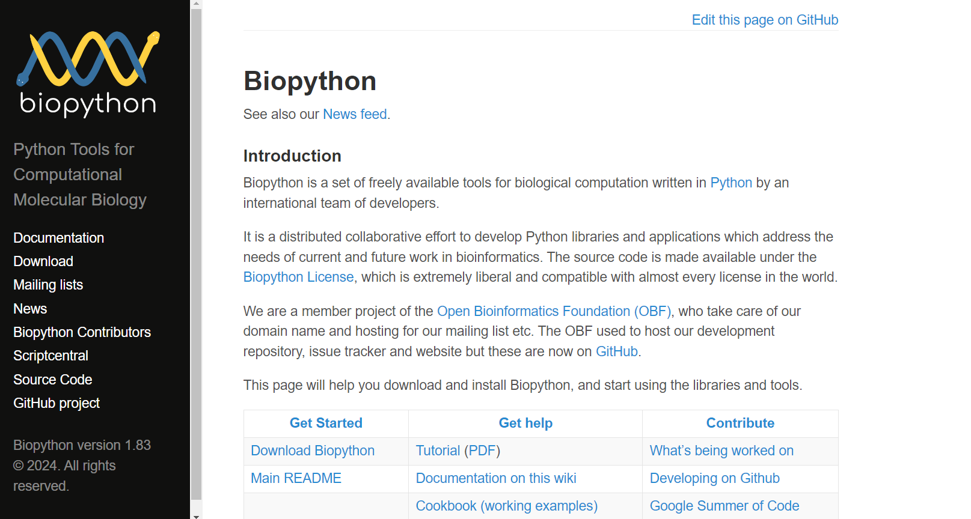

Slide 10
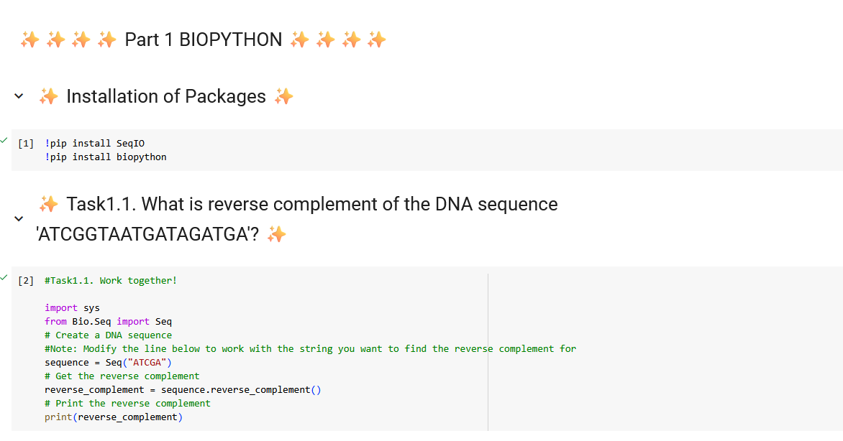

Slide 11
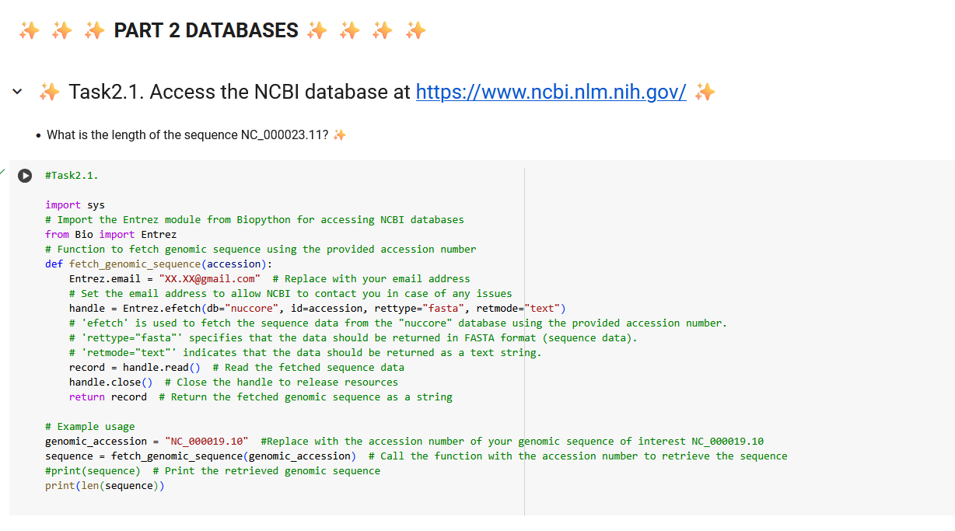

Slide 12
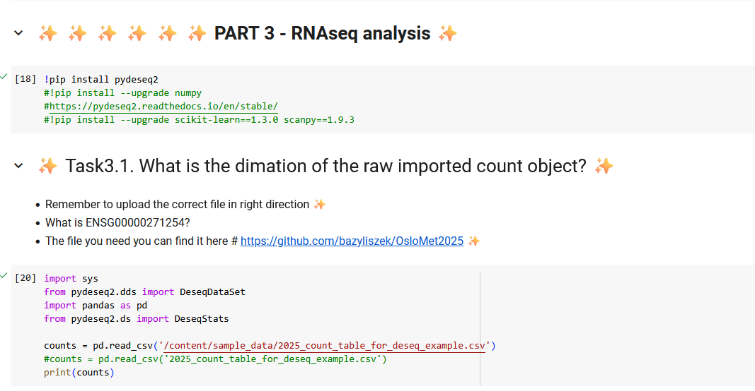

Slide 13
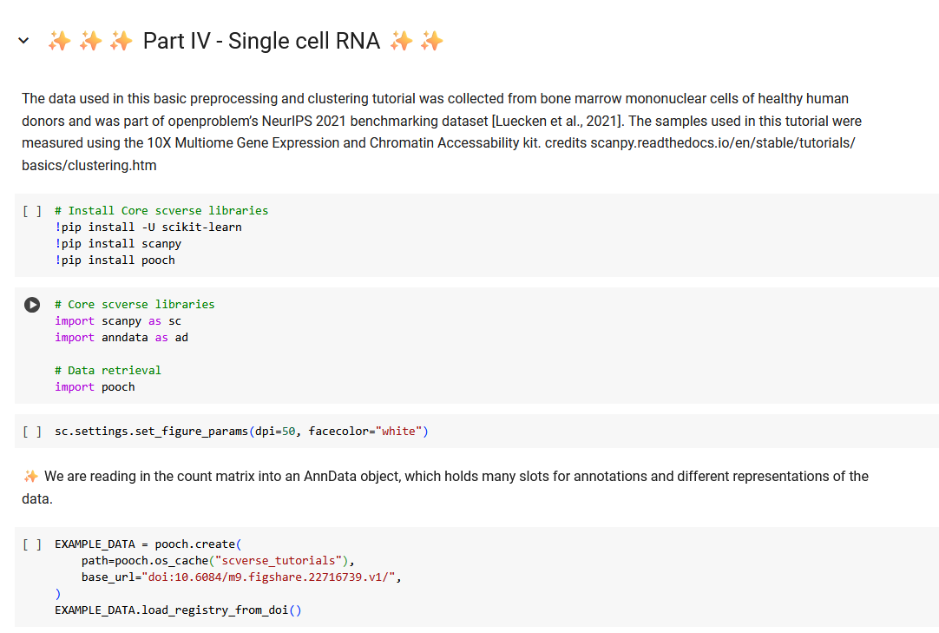

Slide 14
Single-cell RNA sequencing (scRNA-seq) allows researchers to analyze gene expression at the individual cell level, providing insights into cellular heterogeneity within a population. A crucial step in scRNA-seq data analysis is clustering, which groups cells with similar expression profiles, aiding in the identification of distinct cell types or states.​
The Scanpy tutorial on preprocessing and clustering offers a comprehensive guide to this process, using data from bone marrow mononuclear cells of healthy human donors. The key steps include:​
scanpy.readthedocs.io
* Quality Control (QC): Assessing and filtering cells based on metrics like gene count, total counts, and mitochondrial gene expression to ensure data reliability.​
* Normalization: Adjusting for differences in sequencing depth across cells to make gene expression levels comparable.​
* Feature Selection: Identifying highly variable genes that capture the most significant biological variation for downstream analysis.​
* Dimensionality Reduction: Techniques like Principal Component Analysis (PCA) reduce data complexity while preserving essential information.​
* Neighborhood Graph Construction and Visualization: Building a graph based on cell similarities and visualizing it using methods like UMAP or t-SNE.​
* Clustering: Applying algorithms such as Leiden or Louvain to detect groups of similar cells within the data.​
* Re-assessing Quality Control and Cell Filtering: Reviewing QC metrics post-clustering to refine the analysis.​
* Manual Cell-Type Annotation: Assigning biological identities to clusters by comparing marker genes with known cell-type signatures.​
Notes:
https://www.youtube.com/watch?v=8sOKIjEcbPc&t=9s

Slide 15

High Performance Computers - National Infrastructure
https://www.sigma2.no/

Slide 16

High Performance Computers - National Infrastructure
https://www.sigma2.no/

Slide 17
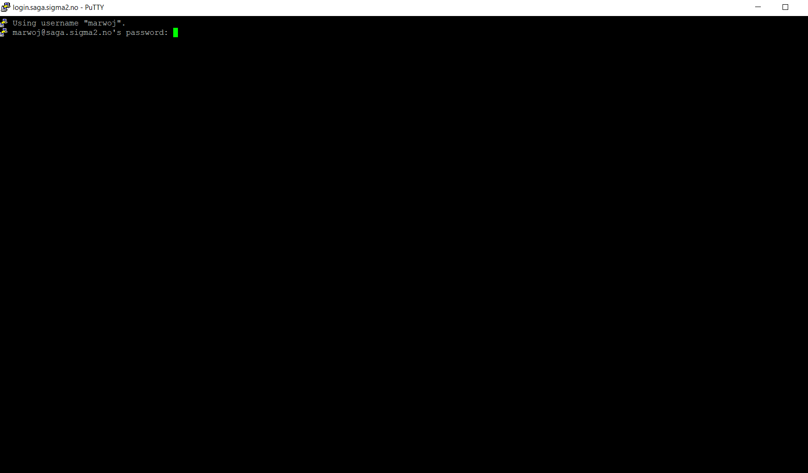
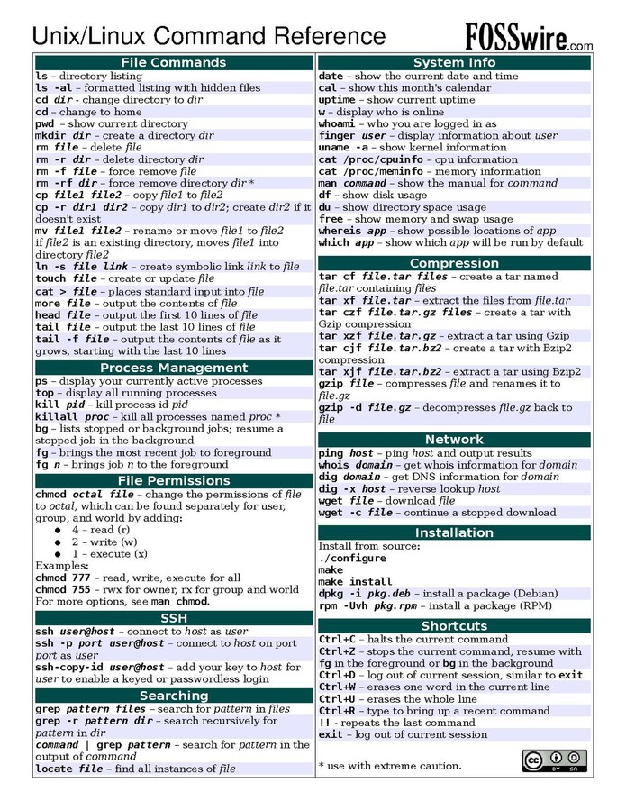
UNIX
- cd
- mkdir
- rsync
Notes:
https://commons.wikimedia.org/wiki/File:Unix_command_cheatsheet.pdf

Slide 18
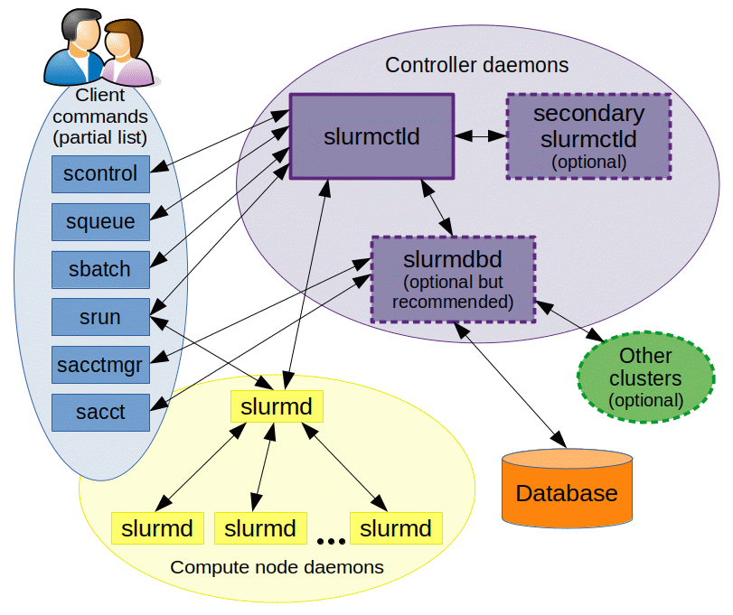

https://slurm.schedmd.com/overview.html

Slide 19
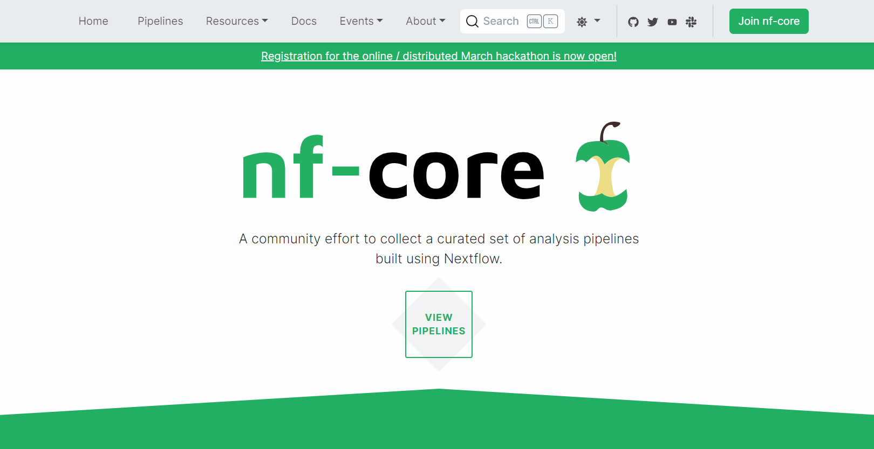

Slide 20
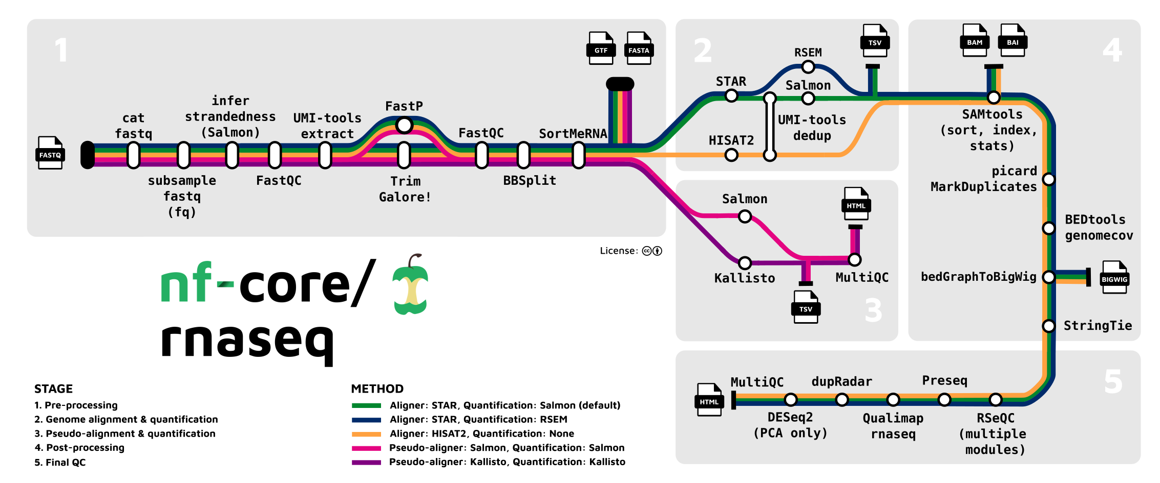

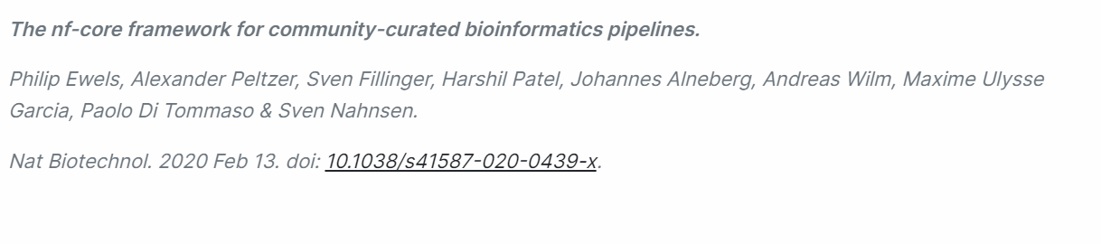
https://nf-co.re/rnaseq/3.14.0
This Photo by Unknown Author is licensed under CC BY

Slide 21


Slide 22

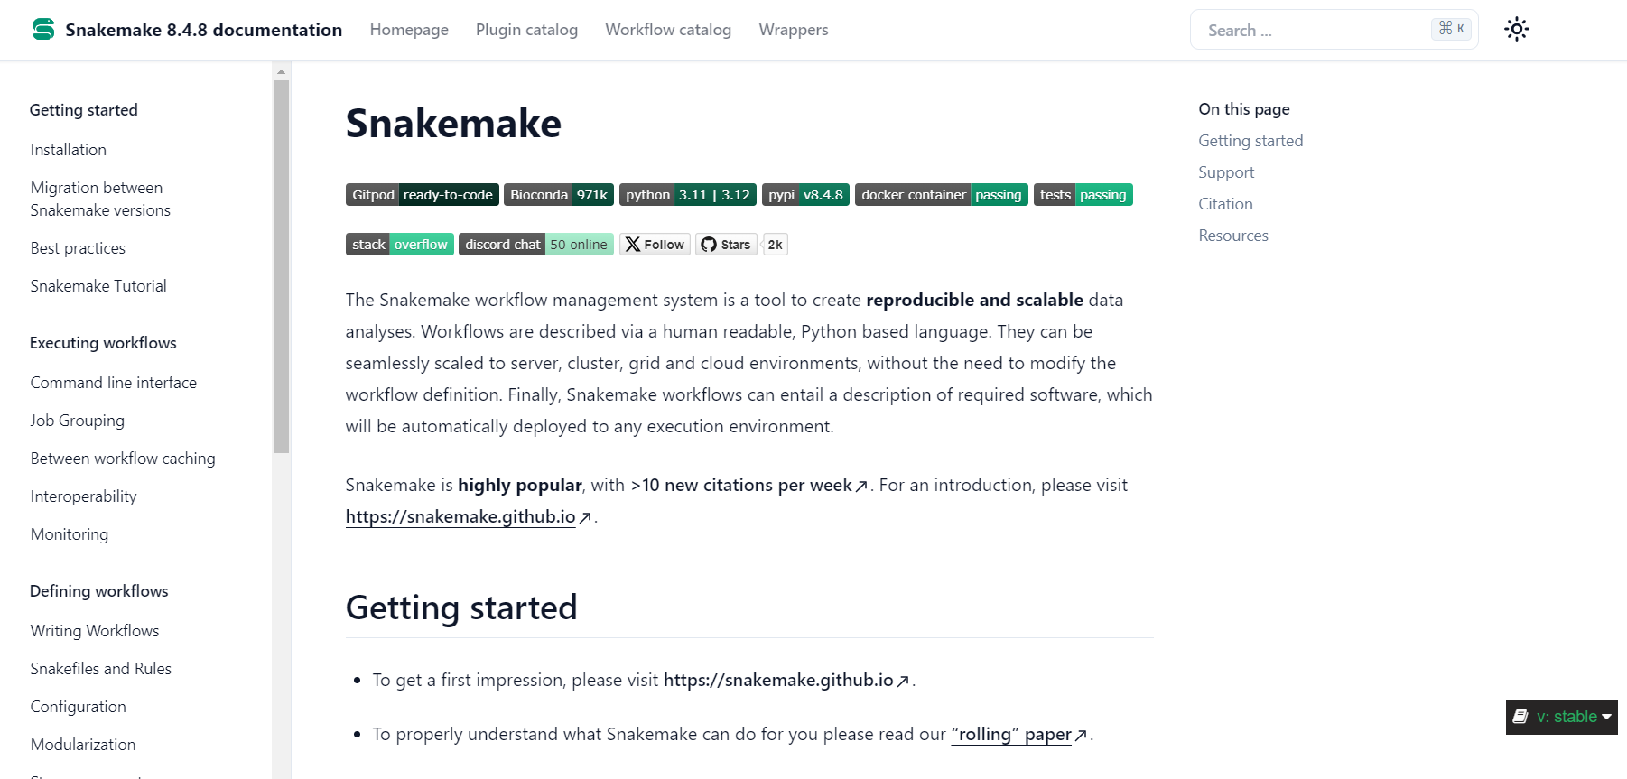

Slide 23

Python, R, Julia, Java, C++, Matlab?

Slide 24
Toolbox for bioinformatics
When to use Python?
Today tasks?

Slide 25
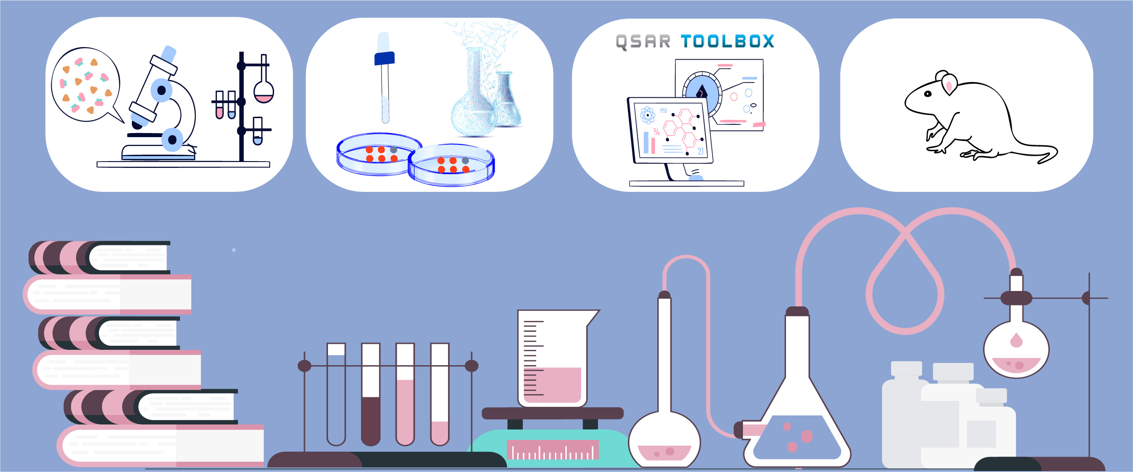
Integrated Approaches to Testing and Assessment (IATA)
https://www.oecd.org/chemicalsafety/risk-assessment/iata/
Notes:
AOP also belong to something that is called IATA.
What information is integrated in an Integrated Approaches to Testing and Assessment?
IATAs can include a combination of methods [(Q)SAR, read-across, in chemico, in vitro, ex vivo, in vivo] or omic technologies (e.g. toxicogenomics), the results of which are integrated.
How do IATAs help reduce animal testing?
As a first step in building the IATA, existing data are collected. Additional testing is only conducted if the available information is not adequate to answer the question. In many cases, additional information can be obtained from in vitro testing or computational models, and animal testing may not be necessary.
IATAs are frameworks for integrating information. The term “new approach methods” can include in vitro (e.g. omics, cell-based, tissue-based, etc.) assays, in silico (e.g. [Q]SARs, expert systems, etc.) models, and other biotechnological and computational approaches. IATAs often include data from NAMs.
In addition to potentially reducing animal testing, IATAs can leverage existing data and use high-throughput methods to rapidly assess a large number of chemicals. In addition, grouping and read-across approaches allow information on existing chemicals to be used to evaluate the safety of new chemicals, and/or chemicals for which hazard/exposure information is limited (e.g. “data-poor chemicals”).

Slide 26

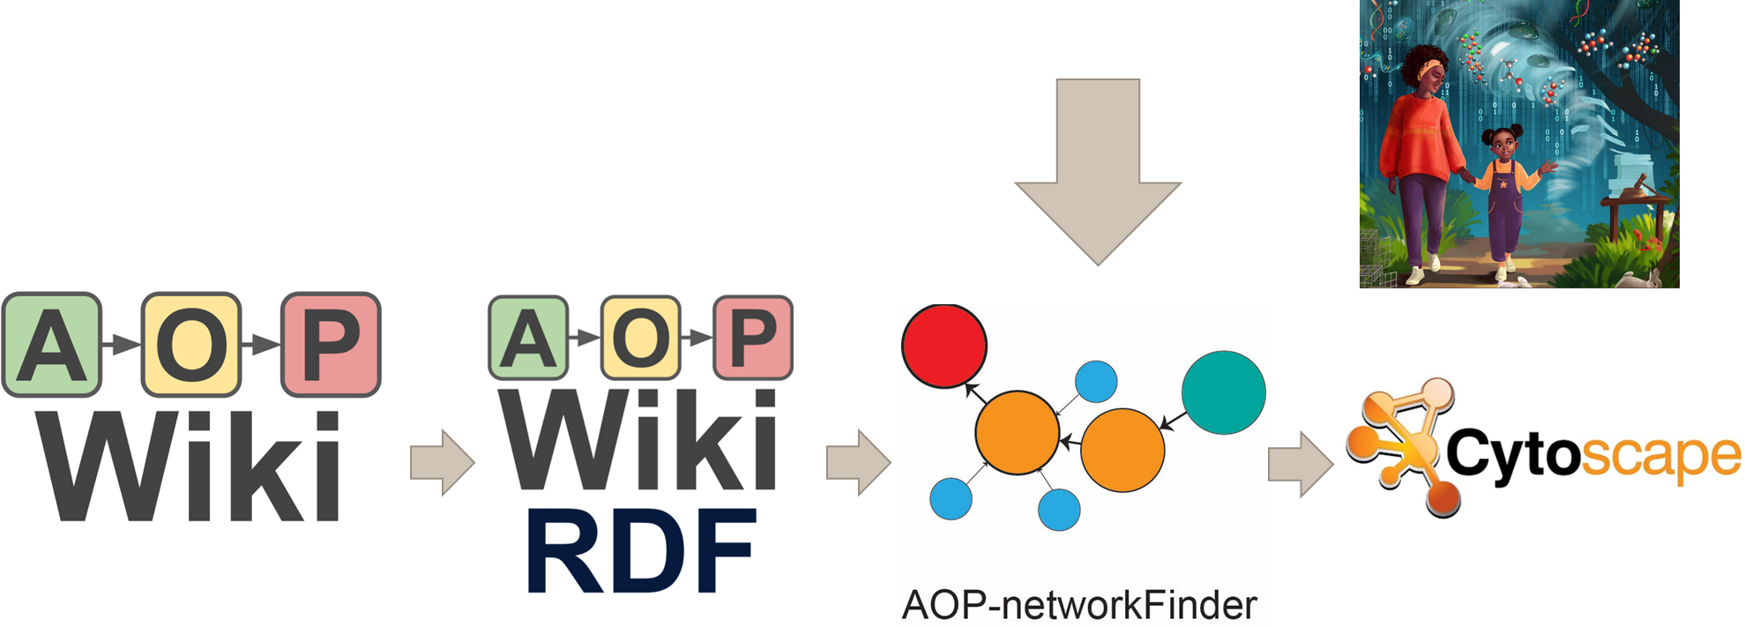
Nurettin Yarar
https://aop-networkfinder.no/

Slide 27
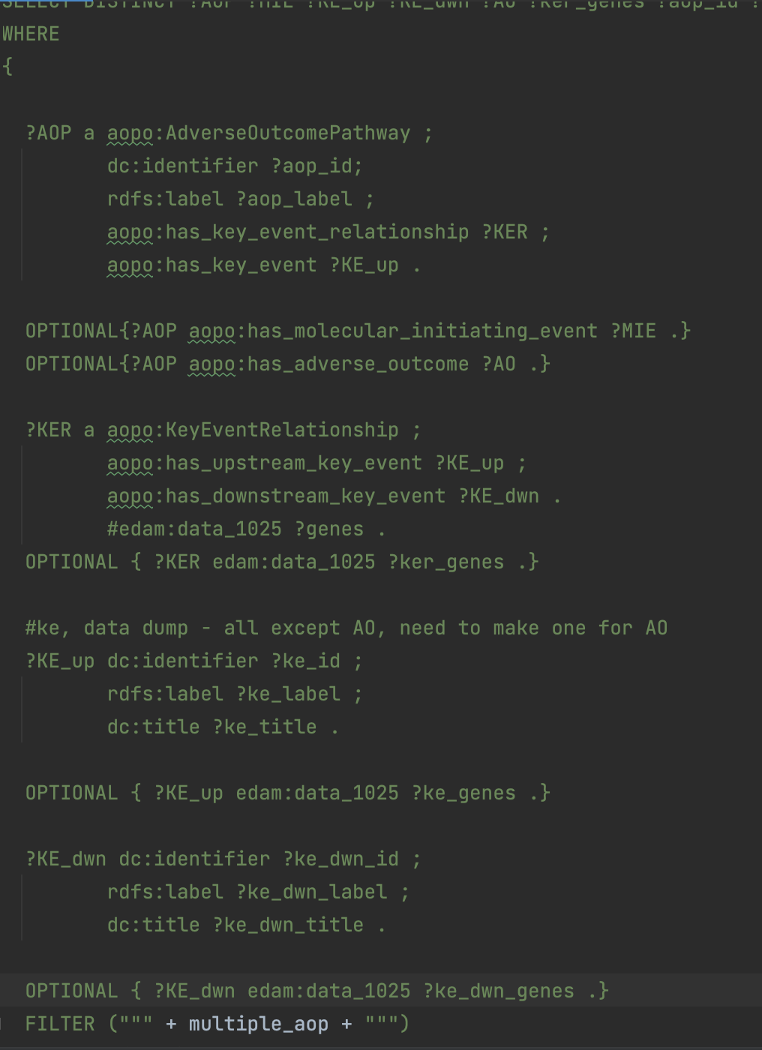

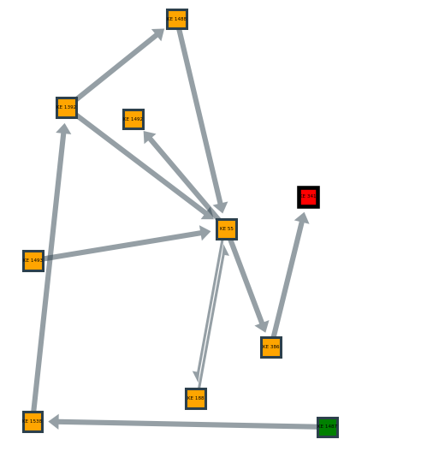
Goal of the application
User friendly tool
Search and extend on existing AOP
‘Predict the effect of a chemical substance’
using Bayesian Network
Client-side
Multipage Application
Page 1: Visualize, manipulate and ‘predict’
Page 2: Raw data
Page 3: Simple text mining tool

Slide 28
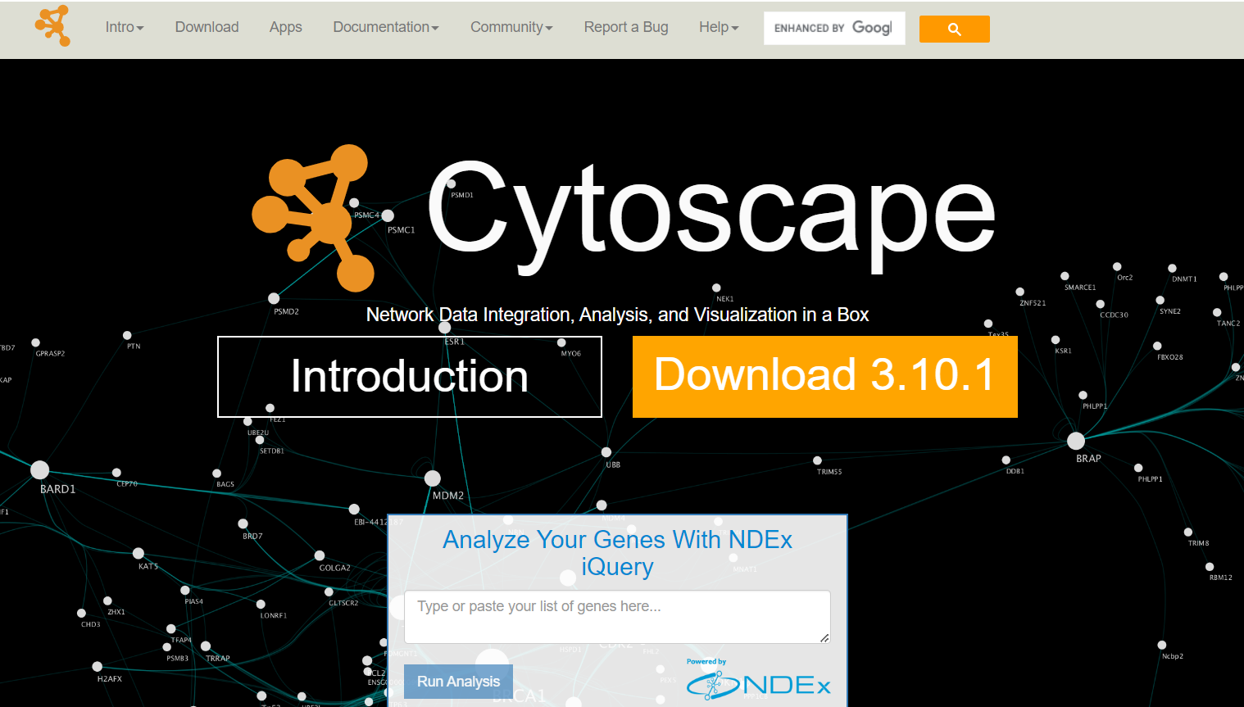

Slide 29

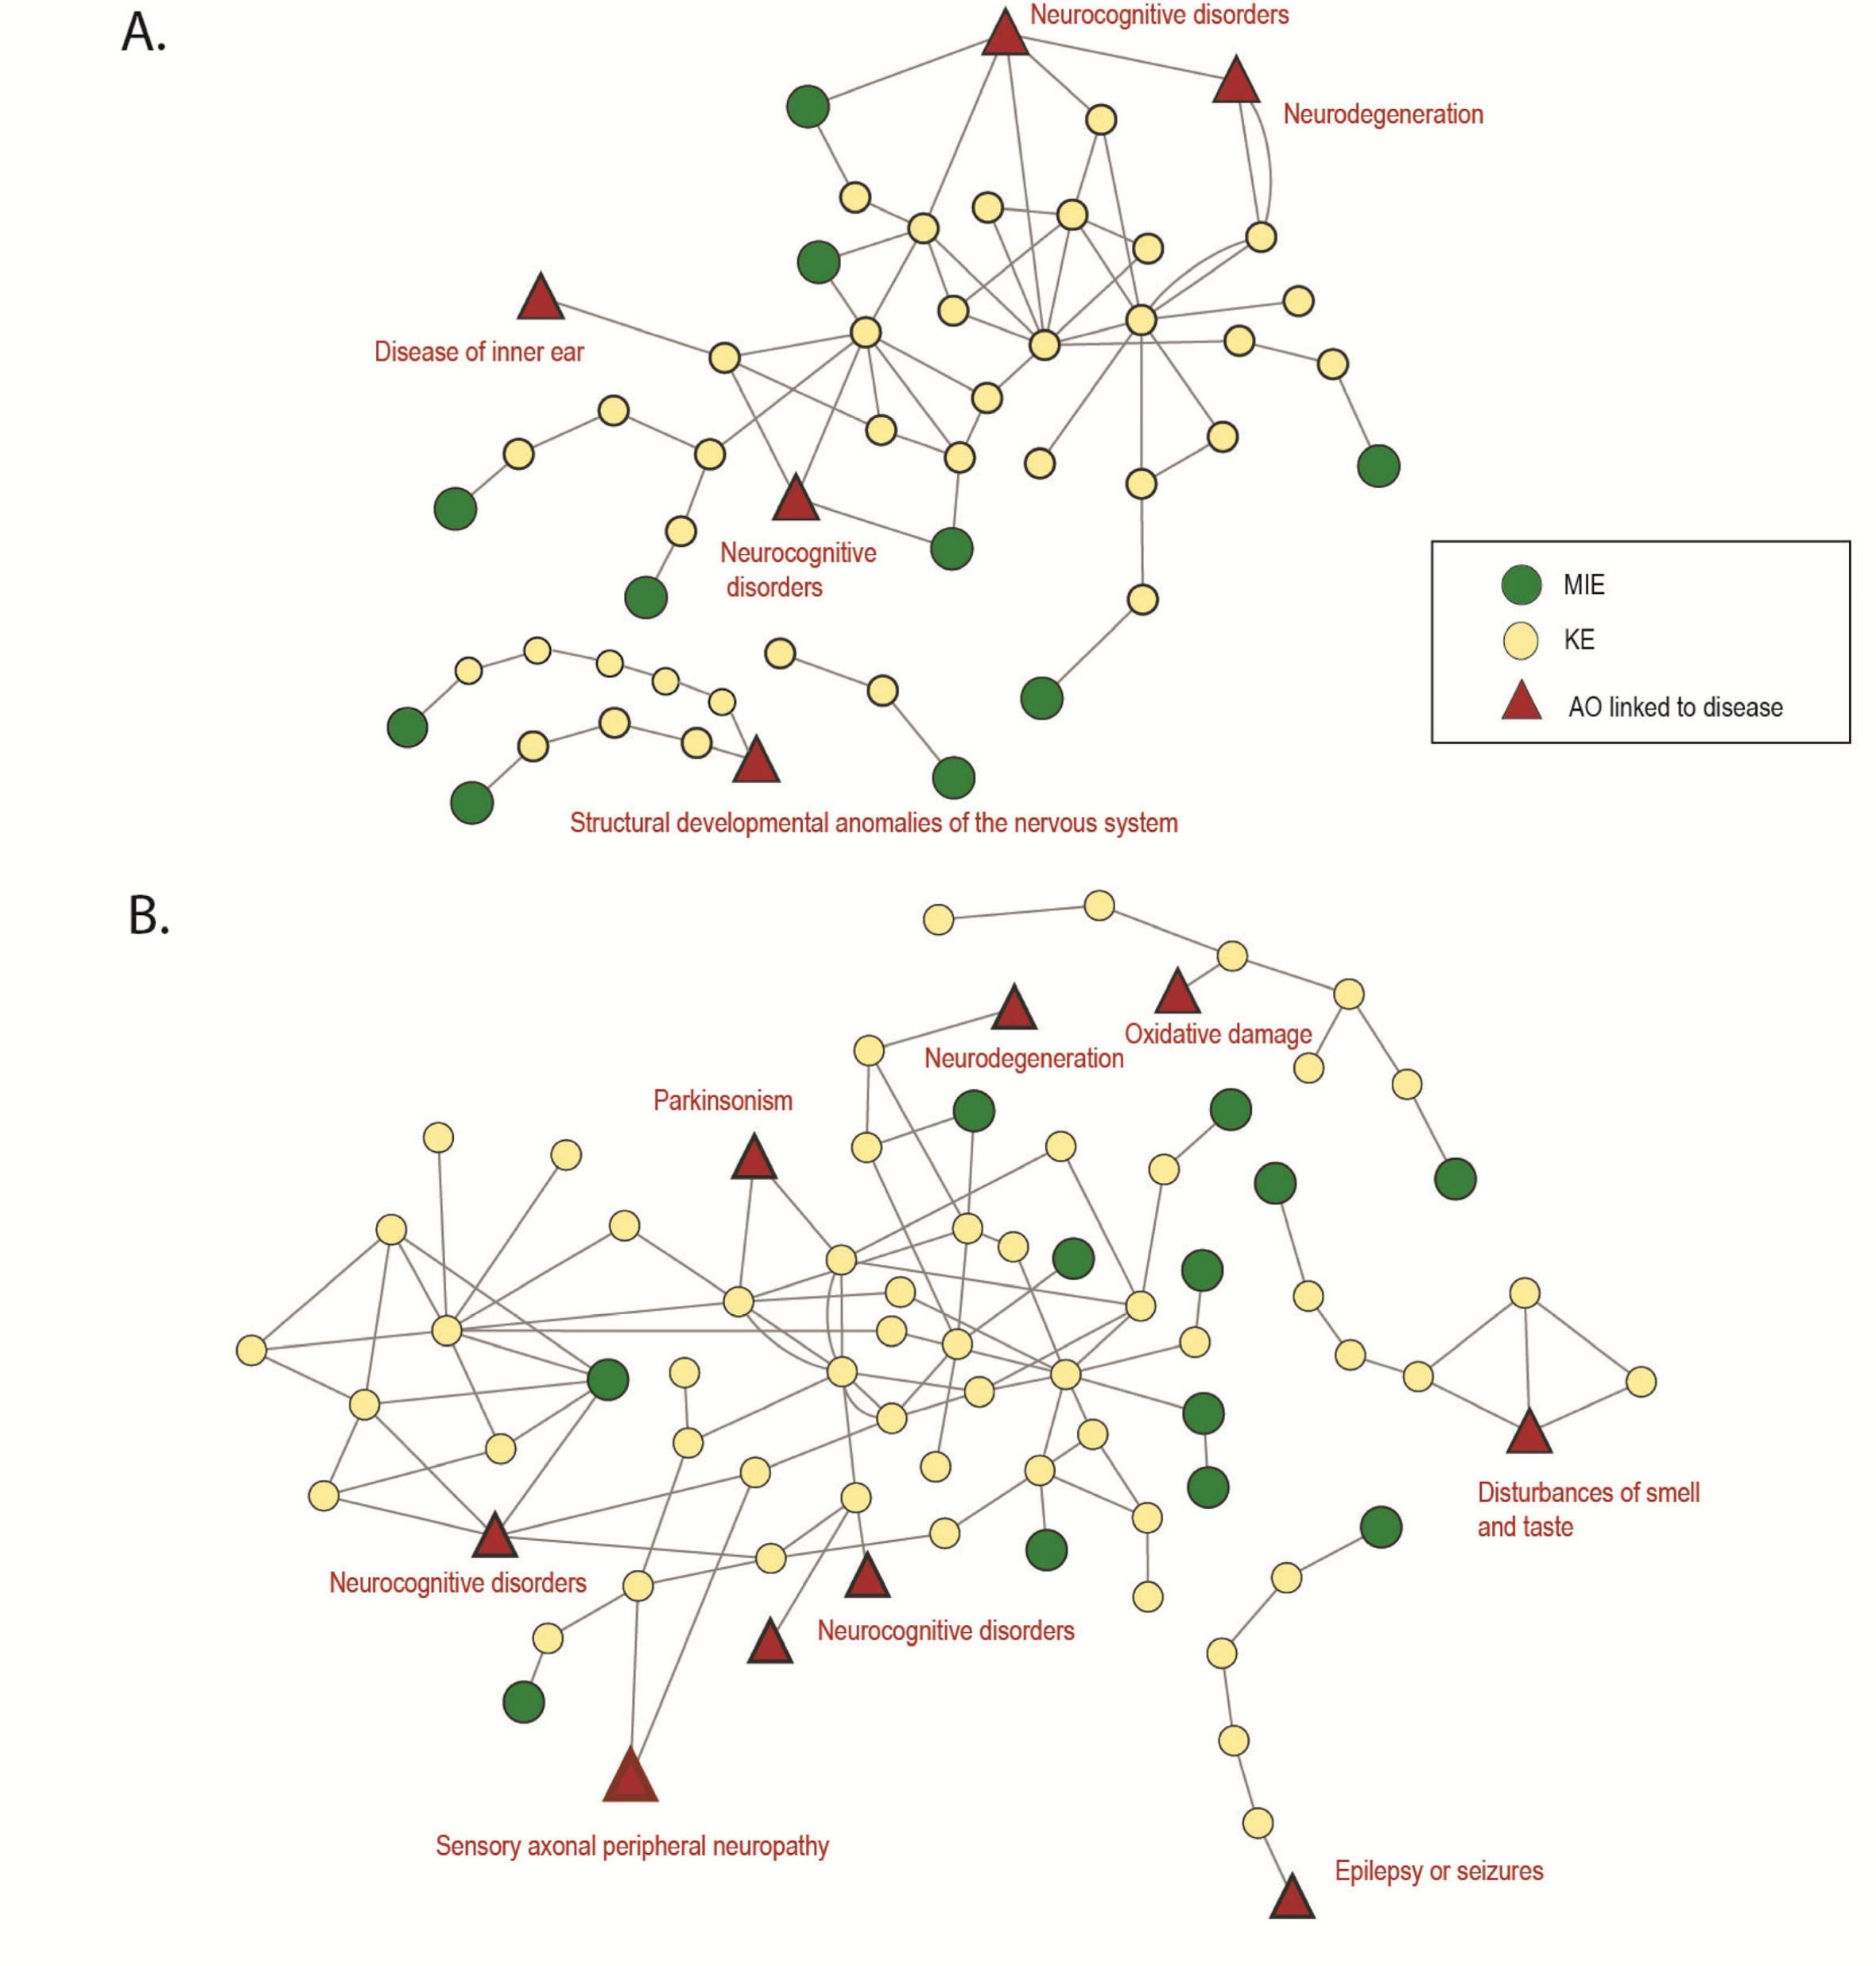
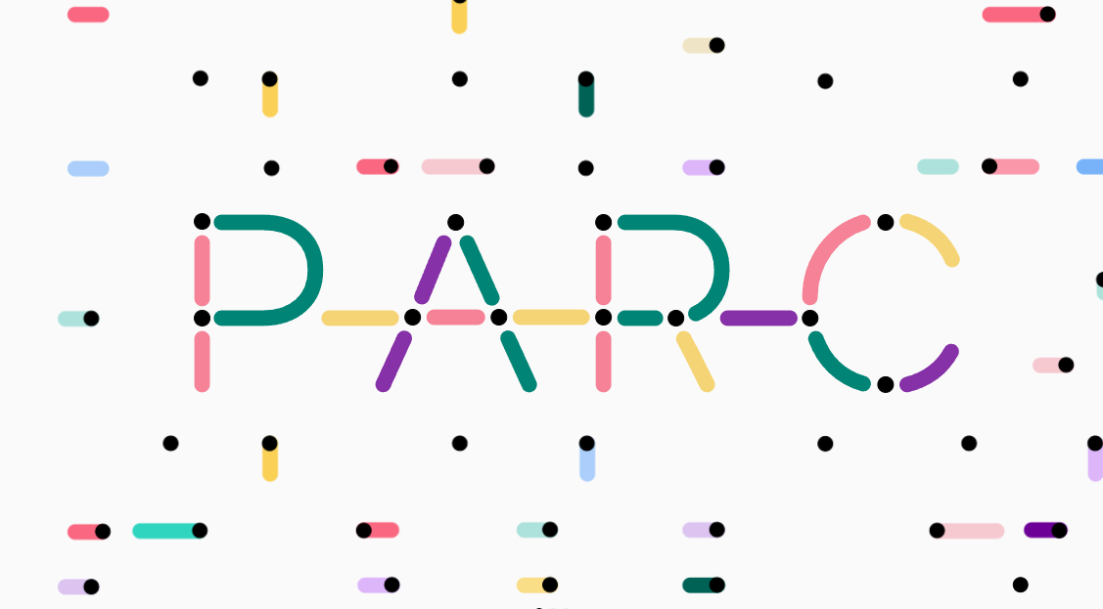
Developmental
neurotoxicity
Adult
neurotoxicity

Slide 30
Toolbox for bioinformatics
When NOT to use Python?
Today tasks?

Slide 31

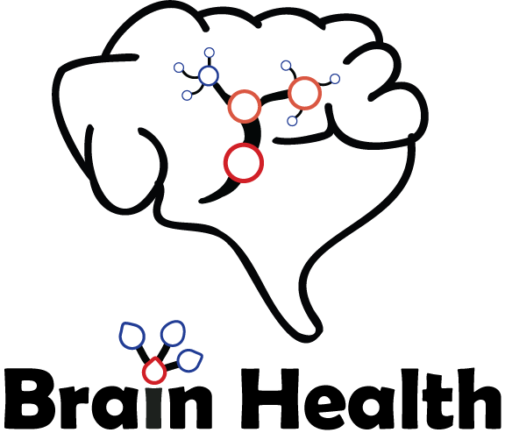
Transcriptomics of neural
stem cell models
DOI: 10.6027/temanord2022-526

Slide 32
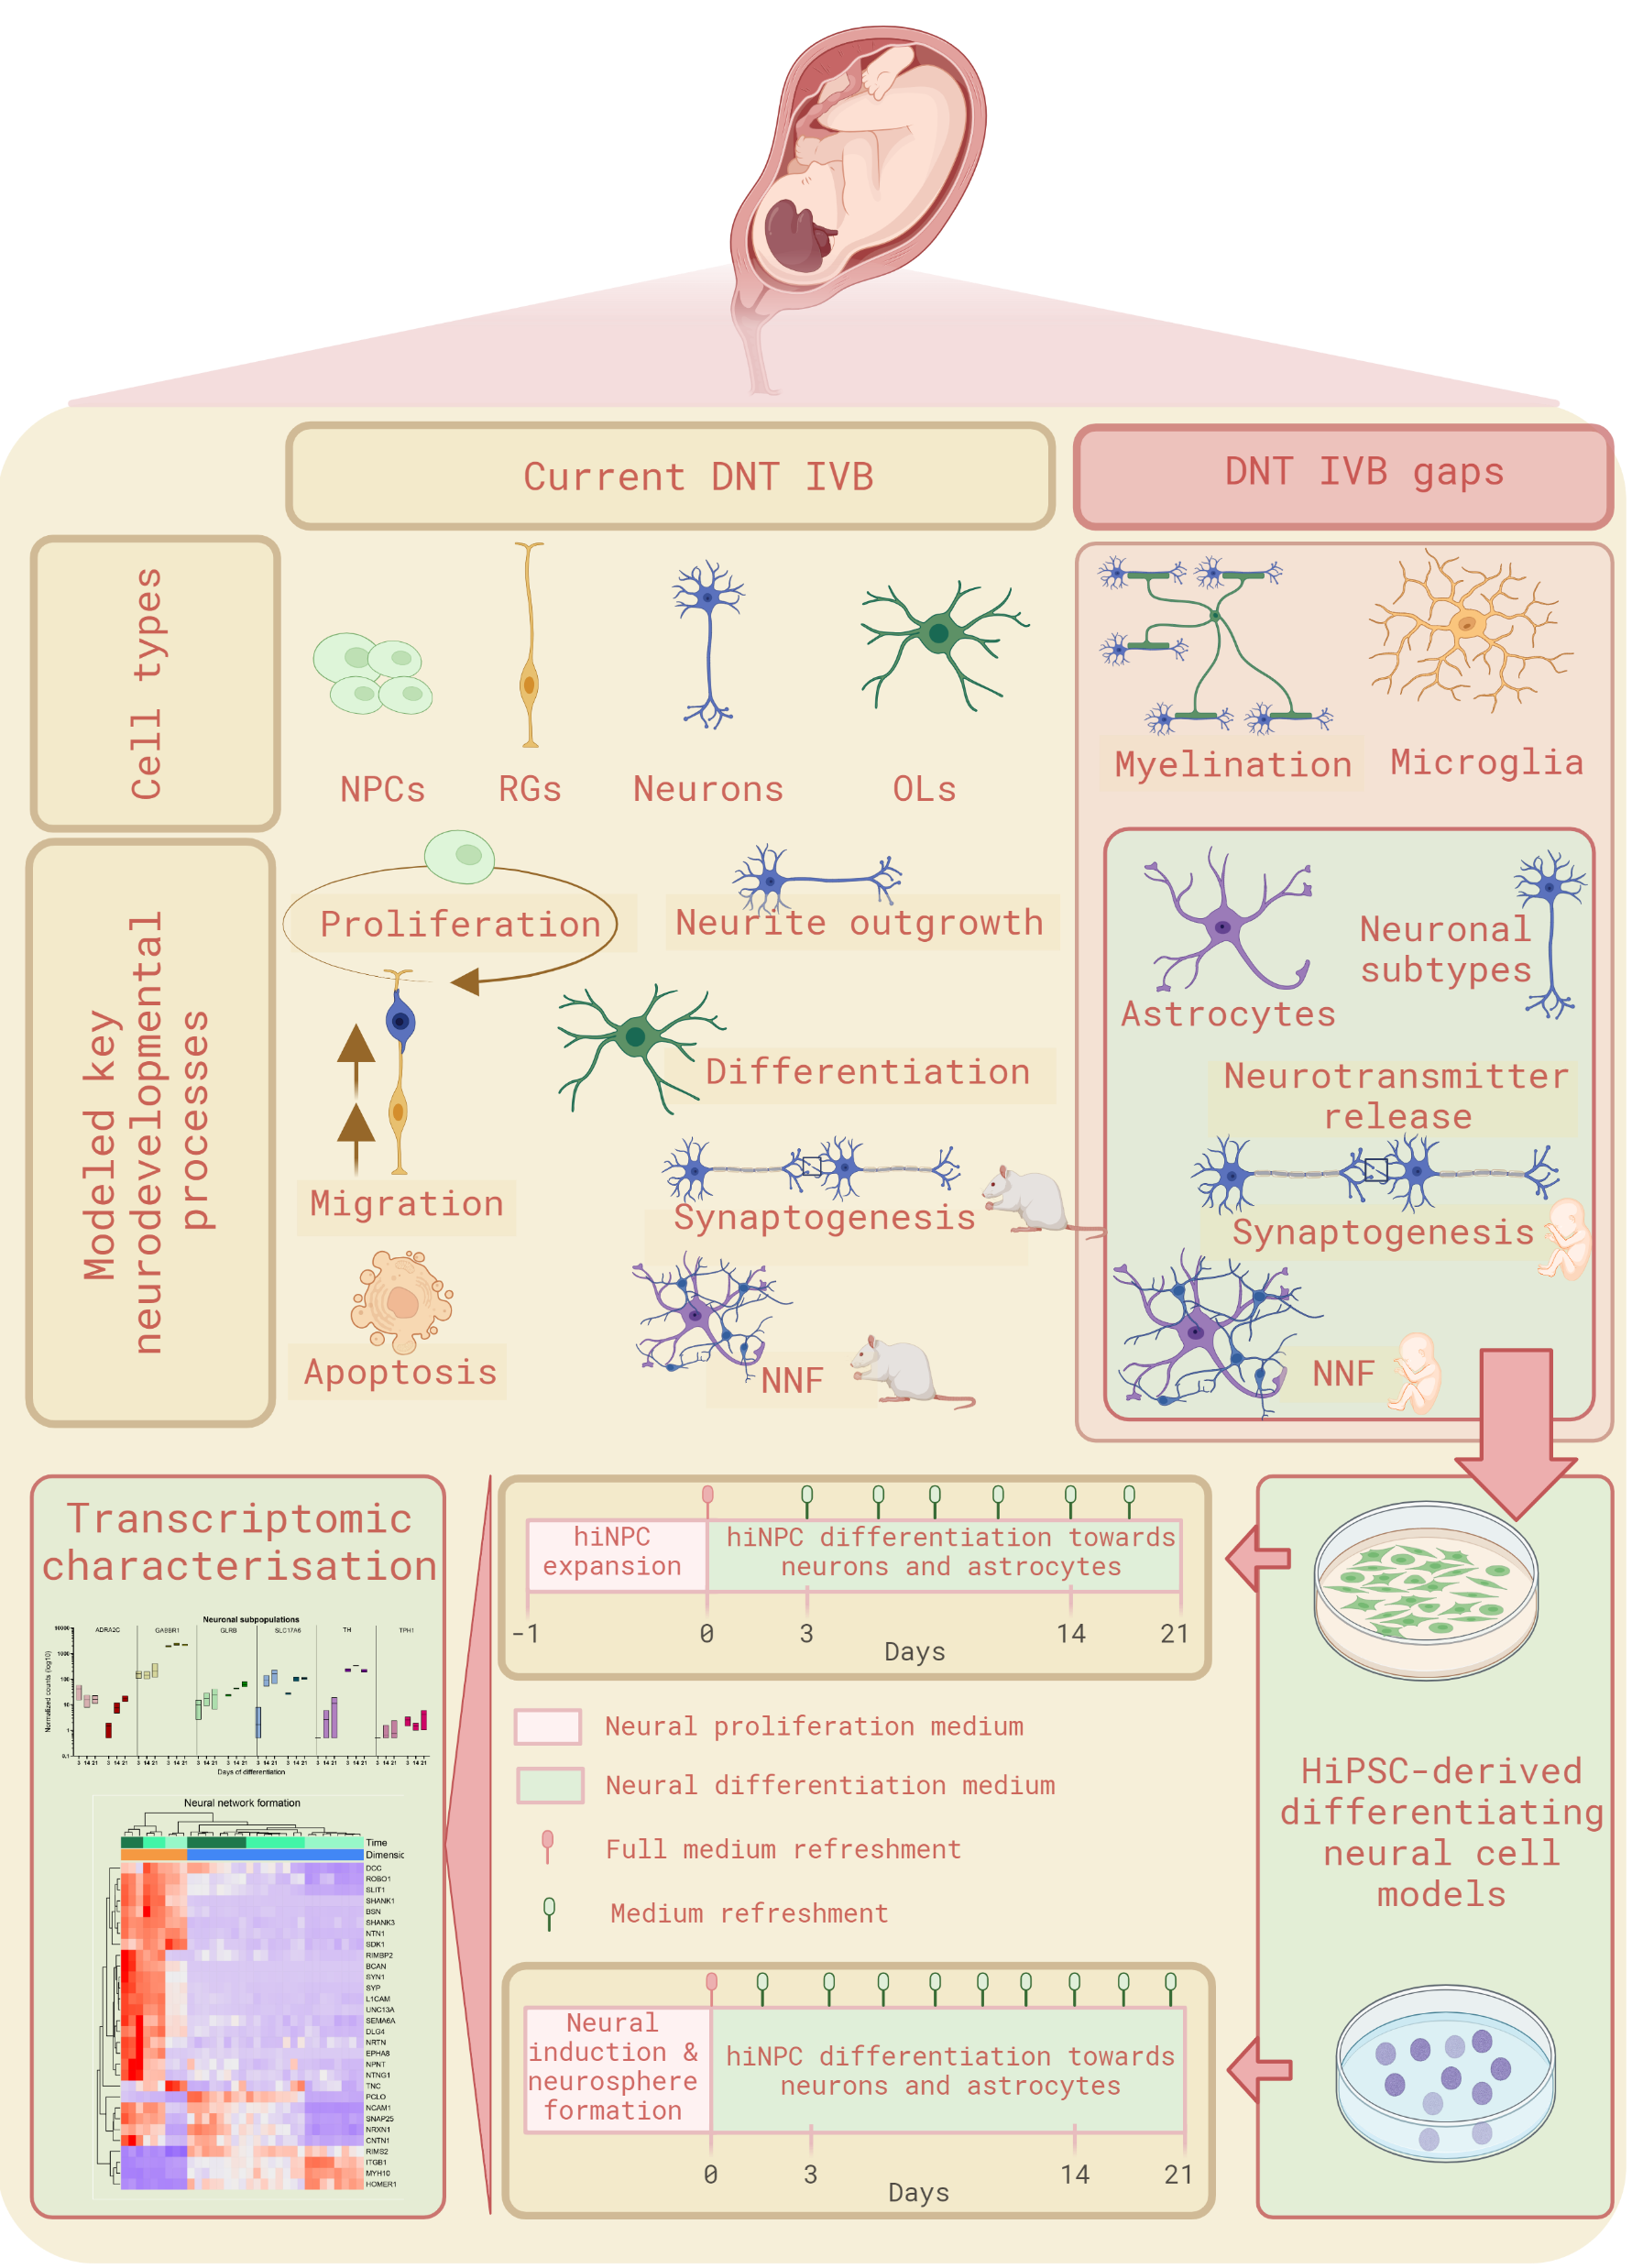


In preparation for:
Contrasts between 3, 14, 21 days
2D and 3D models
Enrichment analysis and targeted analysis
Transcriptomic characterization of 2D and 3D human induced pluripotent stem cell based in vitro New Approach Methodologies for developmental neurotoxicity testing
In preparation for ALTEX Malene Lislien, Julia Kapr, Eliska Kuchovska, Katharina Koch, Nur Duale, Jill Mari Andersen, Hubert Dirven, Oddvar Myhre, Ellen Fritsche, Marcin W. Wojewodzic
Notes:
Graphical abstract of the present study describing in a simplified manner the current DNT-IVB and its gaps (according to OECD 2023). Four of these data gaps are proposed here to be covered by two human-based iPSC-derived cell models cultivated as adherent cell cultures in 2D monolayer and 3D neurospheres undergoing differentiation. A transcriptomics approach was used to characterize and compare the two cell models focusing on DNT-relevant receptors, processes, and pathways. Abbreviations used: DNT-IVB - developmental neurotoxicity in vitro battery, NPCs - neural progenitor cells, RGs - radial glia, OLs - oligodendrocytes, NNF - neural network formation, hiPSC - human induced pluripotent stem cells, hiNPC - human induced neural progenitor cell. Created with biorender.com.

Slide 33
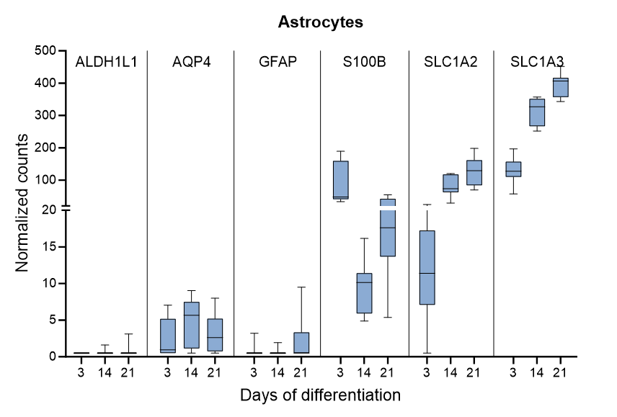
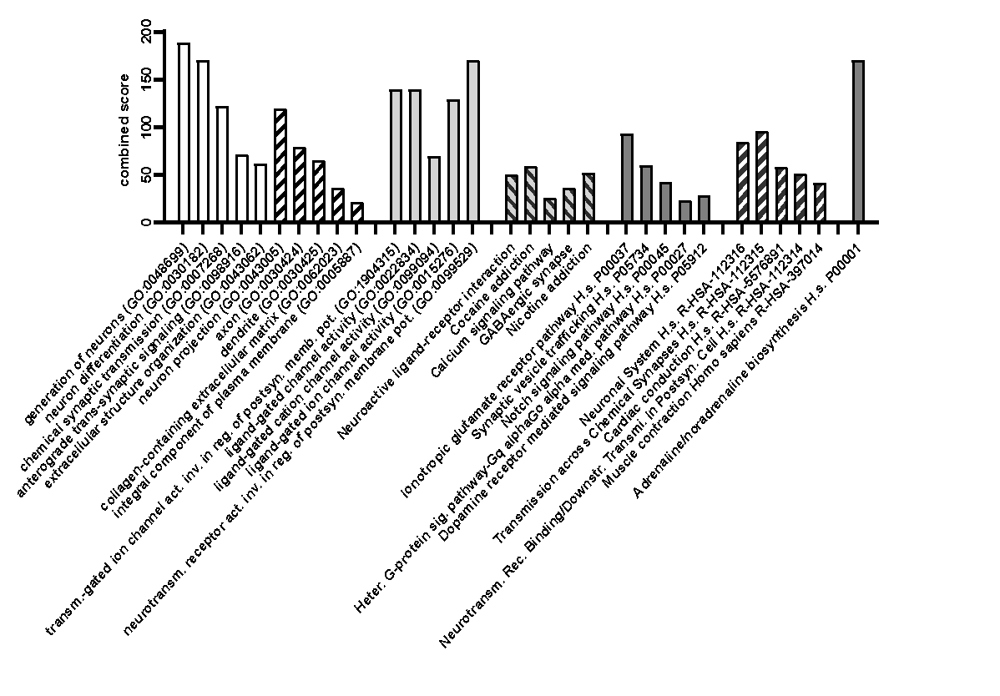
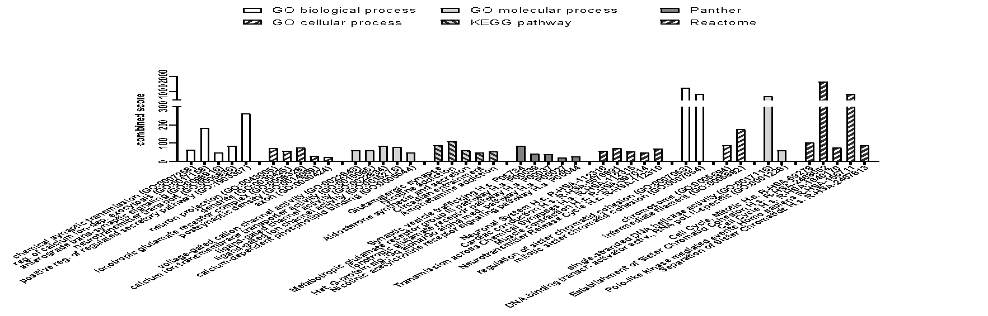
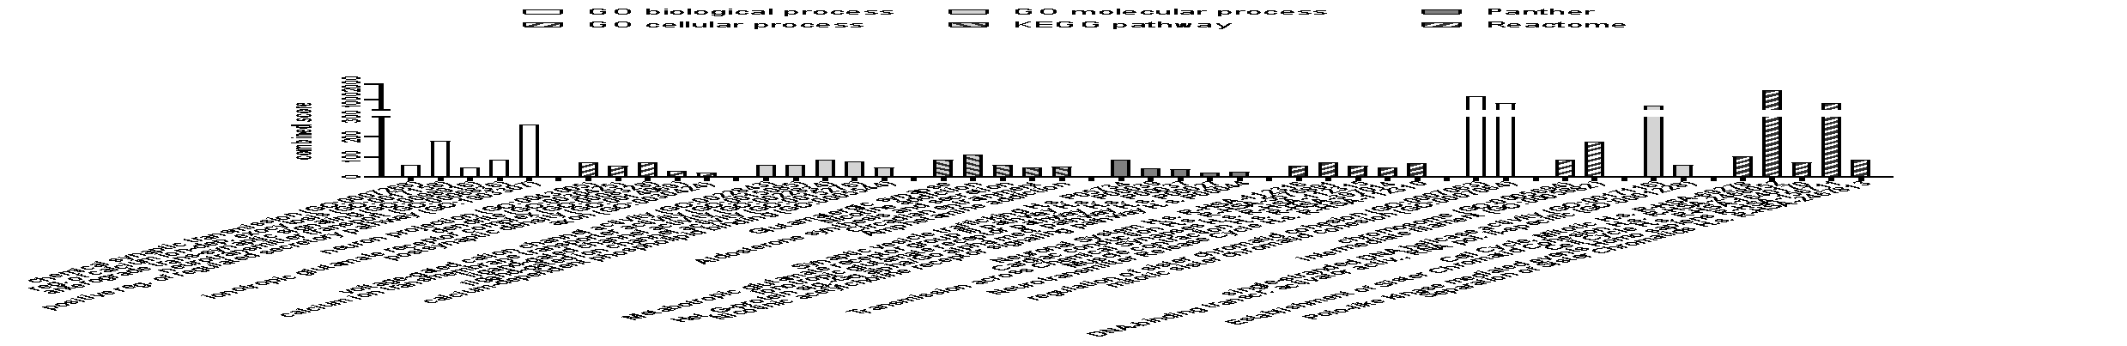

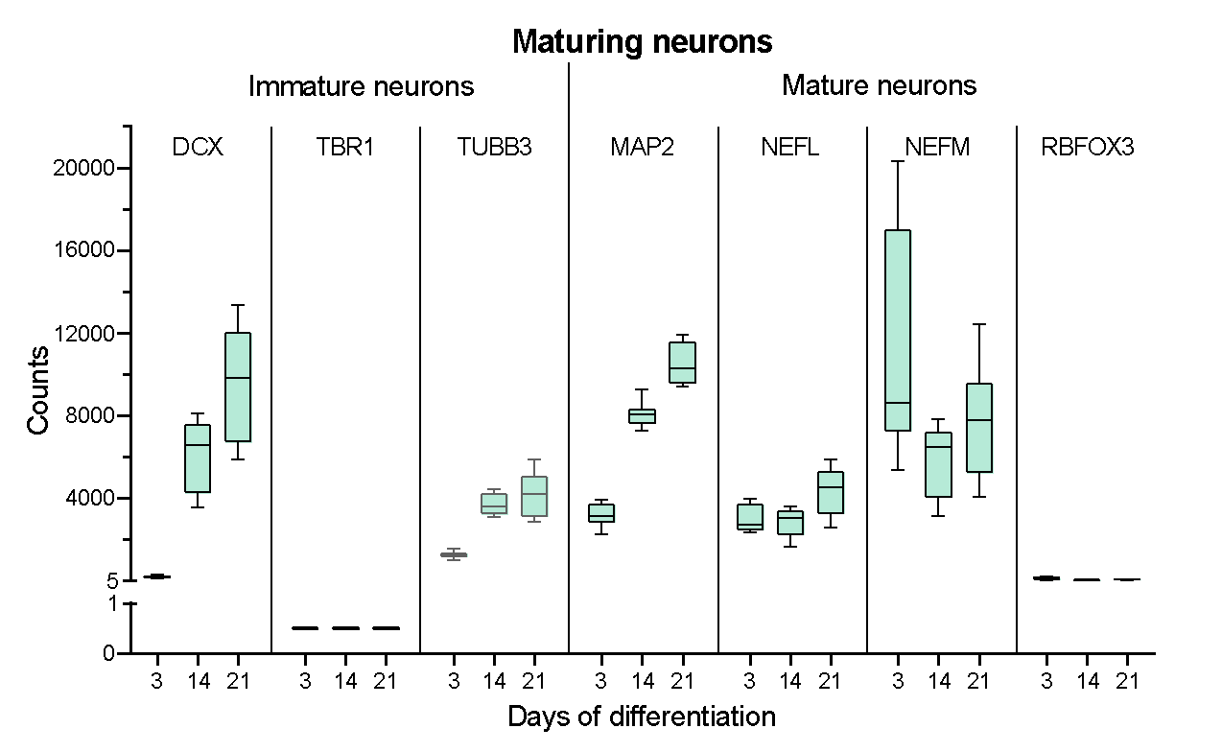
2D model characterization – overview
3 DIV vs 14 DIV
14 DIV vs 21 DIV
In preparation for ALTEX
Notes:
Figure 2. Overview of transcriptomics characterization analysis during the 2D models differentiation process. Left) Bar plot of the number of enriched terms identified when comparing 3 and 14 days of differentiation and 14 and 21 days of differentiation. RIGHT) Box plots of selected gene markers for astrocytes, and maturing neurons, respectively.
Bar plots are visualized with the mean of eight independent experiments and whiskers for min and max on a linear scale. Genes included in the analysis had a cutoff of log fold change +/- 2 and a p < 0.01 of eight independent experiments (cell passages).

Slide 34
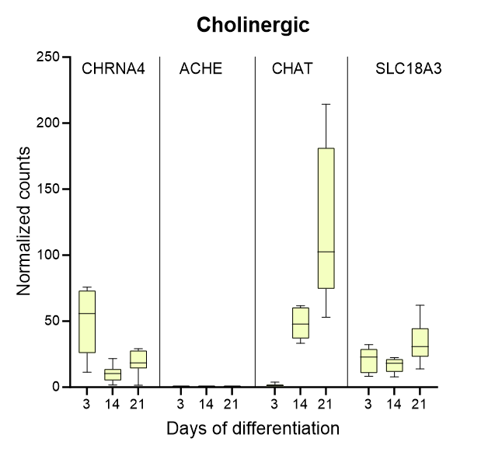
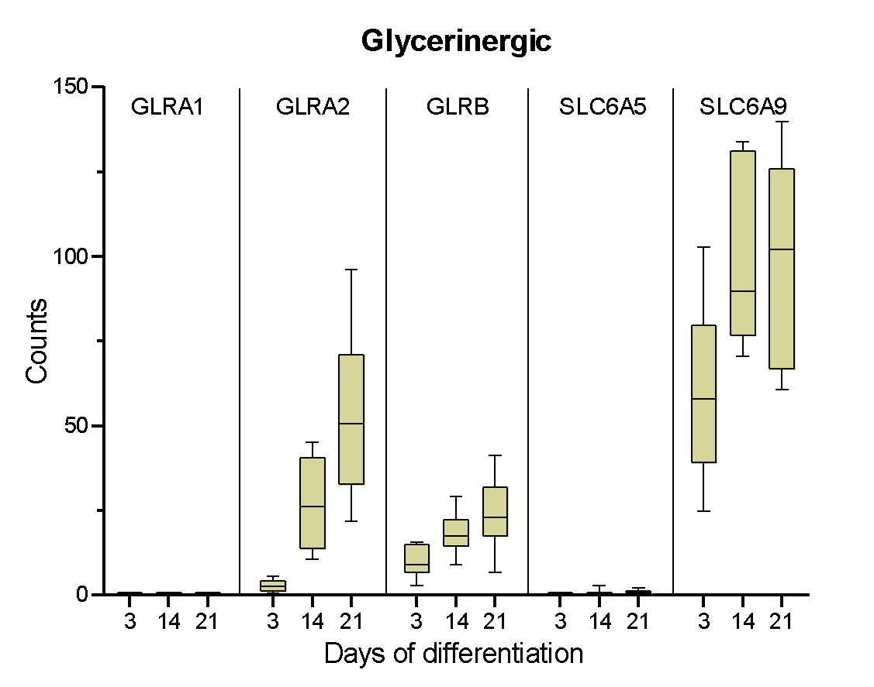
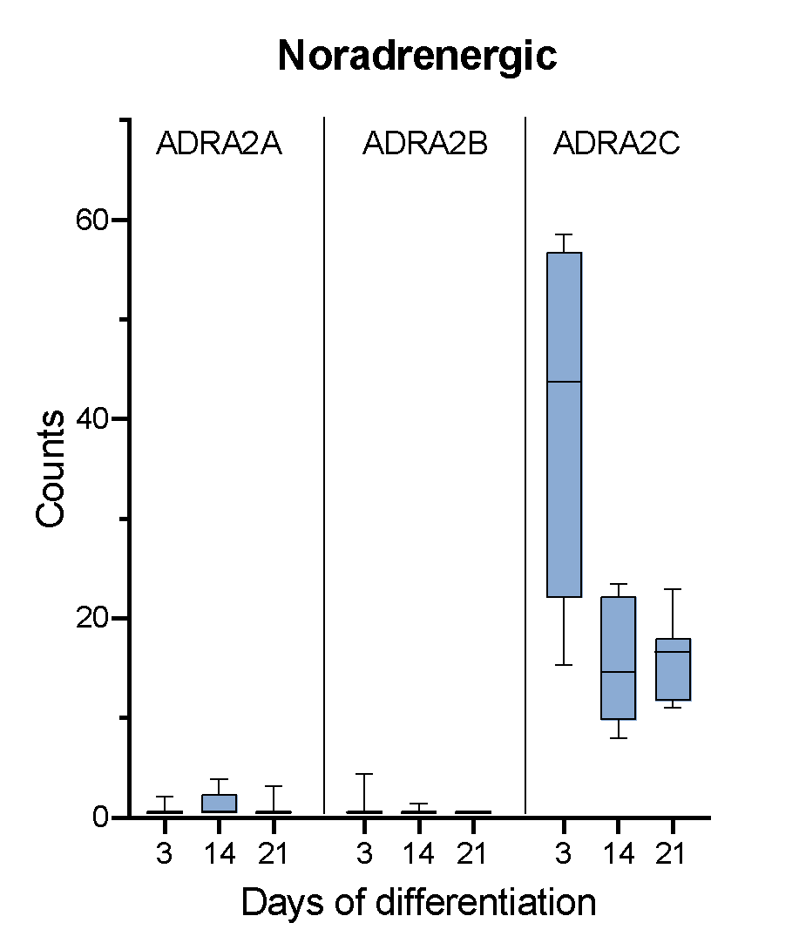
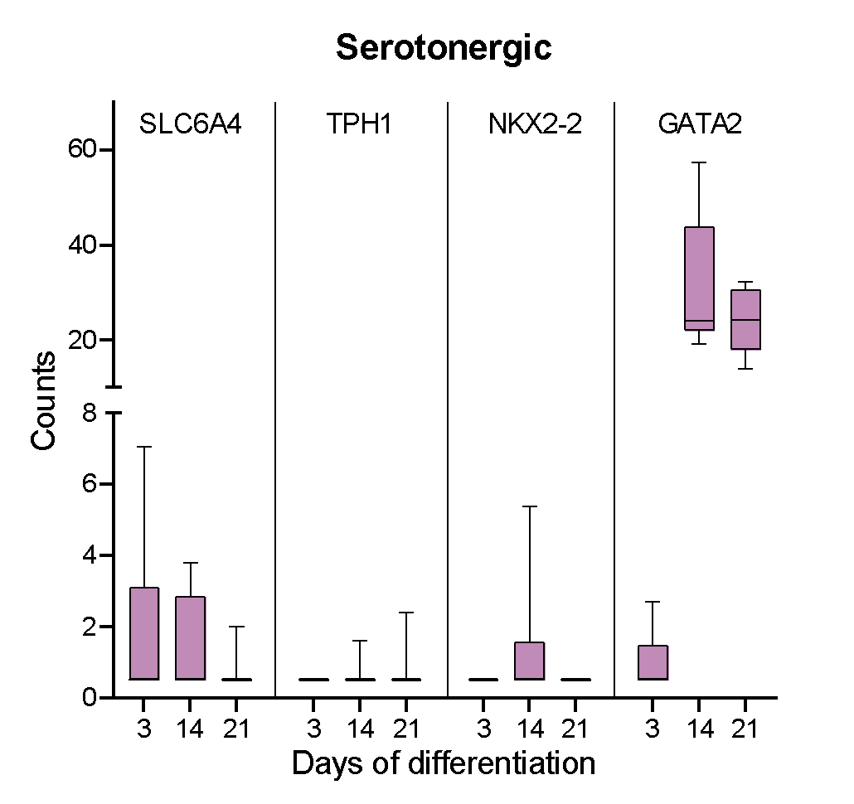
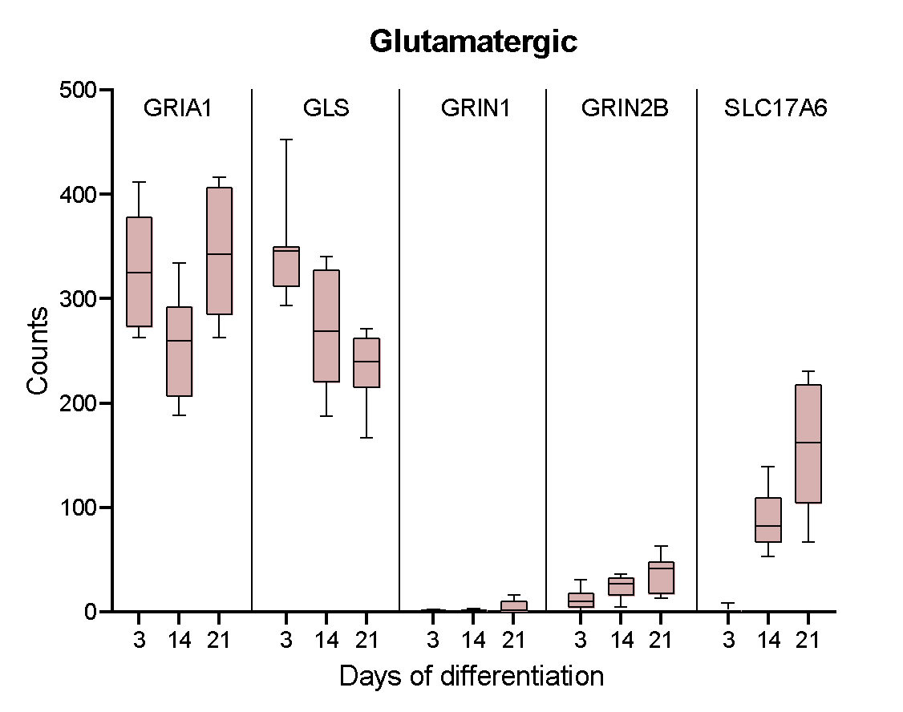
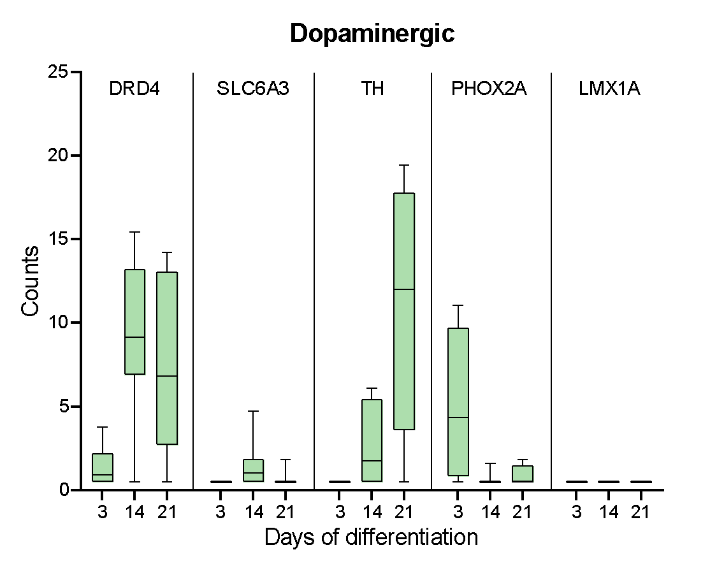
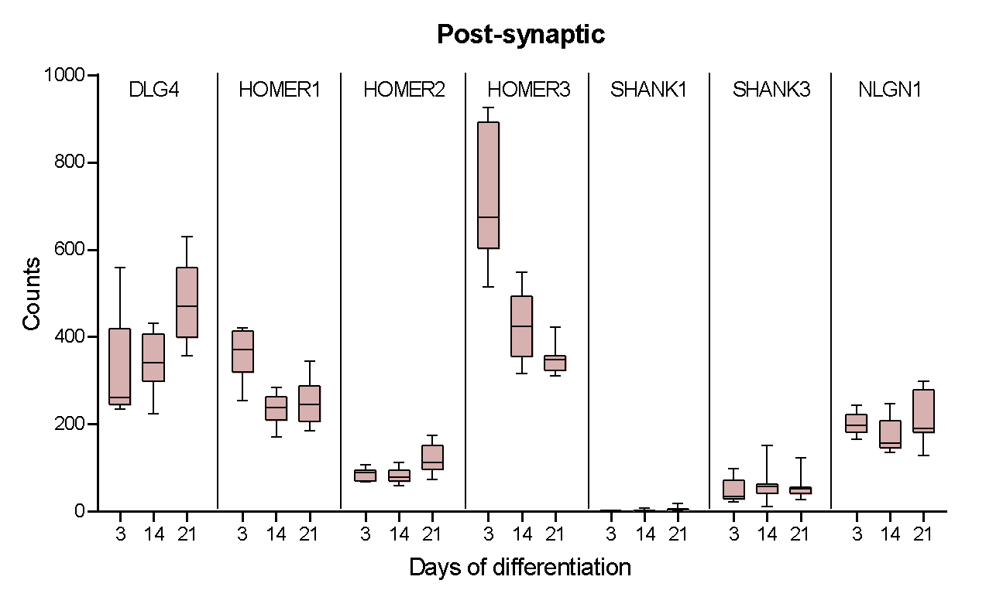
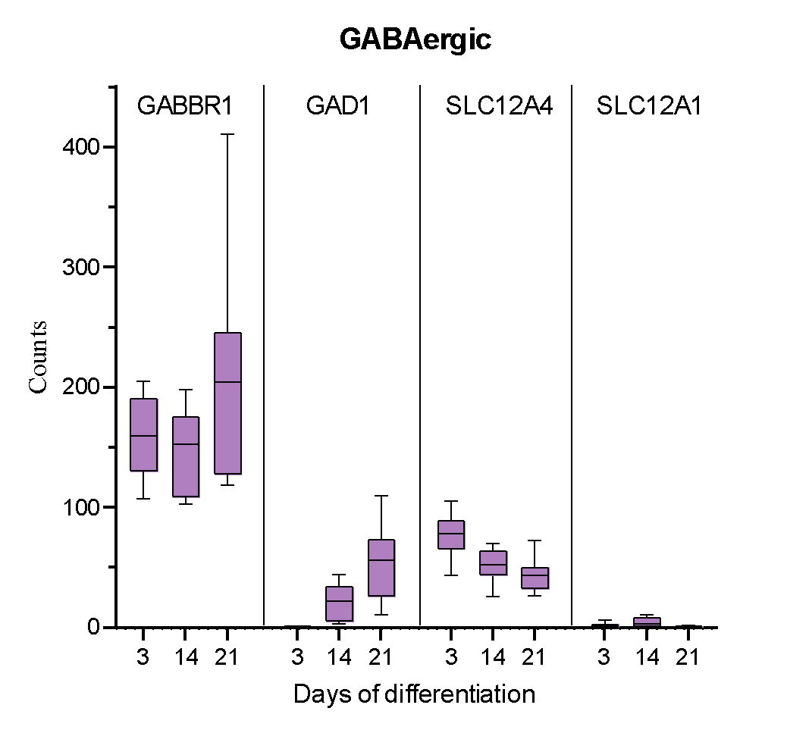
2D model characterization - neural network formation.
A
B
C
D
E
F
G
H
I
In preparation for ALTEX
Notes:
Transcriptomics characterization analysis of neural network formation in the 2D models differentiation timepoints. Box plots of selected gene markers for (A) pre-synapses, (B) post-synapses, and (C-I) different neuronal subtypes. Bar plots are visualized with the mean of eight independent experiments and whiskers for min and max presented on a linear scale. Dark colored boxes utilize the right y-axis whereas light colored boxes utilize the left y-axis. Genes included in the analysis had a cutoff of log fold change +/- 2 and a p < 0.01 of eight independent experiments (cell passages).

Slide 35


Slide 36
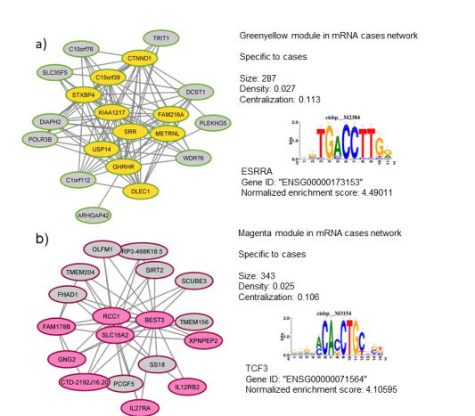
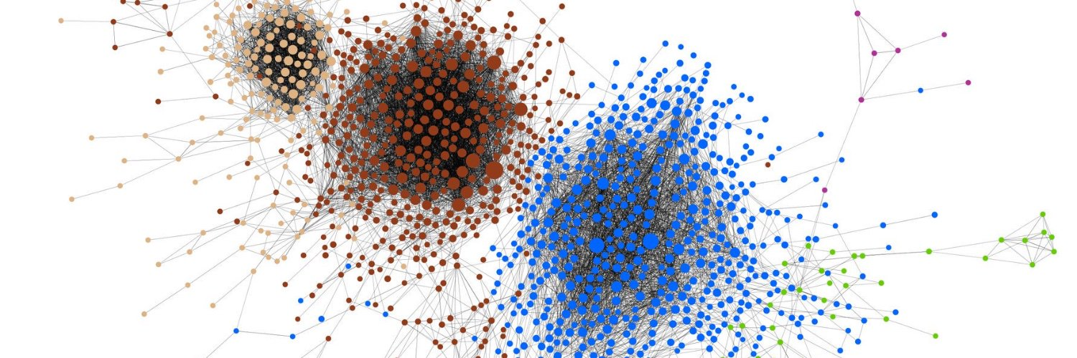
Weighted correlation network analysis - WGCNA
Frisch, Becker, Wojewodzic, 2019, Molecular Biology and Evolution “Dissecting the Transcriptomic Basis of Phenotypic Evolution in an Aquatic Keystone Grazer”
Burton, Rounge, Haugen, Wojewodzic, 2023, Pre-Diagnostic Circulating RNAs Networks Identify Testicular Germ Cell Tumour Susceptibility Genes, medRxiv
Notes:
Myself and with colleagues we have been also describing networks of different phenomena's, from evolution to testicular cancer using transcriptomics data.
In this case, I do not want to say that networks and pathways are chaotic but using them in different contexts can be very important.
It is allowed for for discovery findings to become more rigorous we need another approaches.

Slide 37
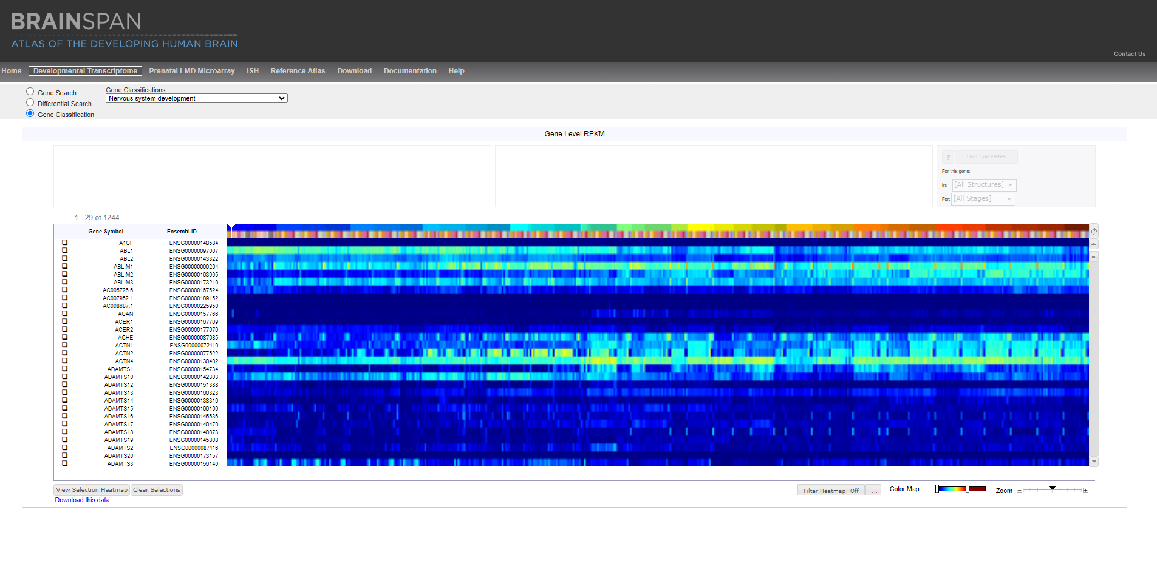
Strategy
Gathering transcriptomic signatures for glial cells
Nervous systems development signatures
https://brainspan.org/rnaseq

Slide 38
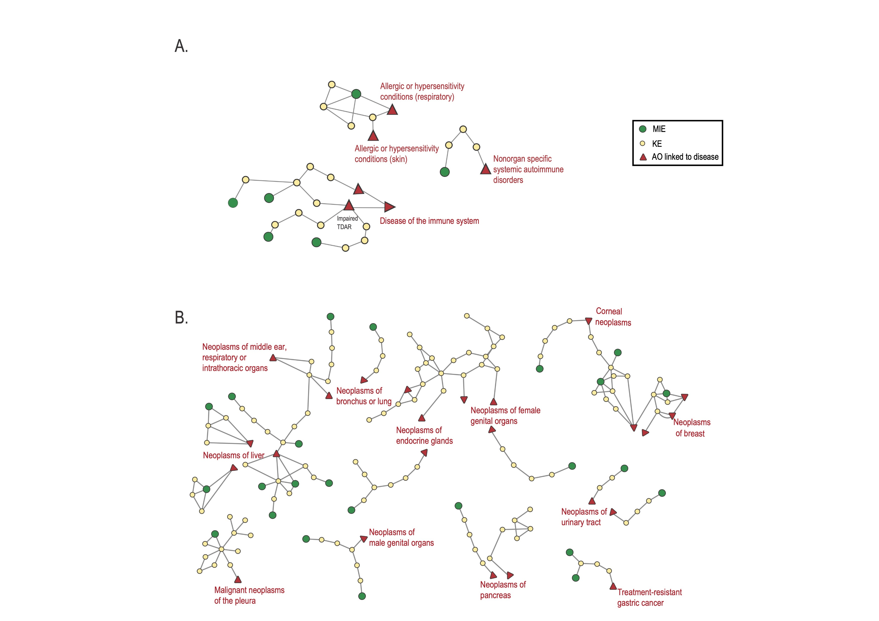
Immunology related
Cancer
Comprehensive mapping of the AOP-Wiki database: identifying biological and disease gaps, submitted Frontiers in Toxicology 2023

